Slide 1
Data and Text Mining
Introduction to Data Mining
2024 / 2025
Nada Lavrač
Department of Knowledge Technologies
Jožef Stefan Institute
Ljubljana, Slovenia

Slide 2
Introduction to Data Mining
6-11-2024
Nada Lavrač: Lesson 1 - Introduction
  Basics of Machine Learning
  Standard learning tasks
  Three generations of machine learning
  Advanced learning tasks
Nada Lavrač: Lesson 2 - Decision Tree Learning
  Basic decision tree learning algorithm
  Entropy and information gain heuristics
  Decision tree pruning
  Selected decision tree learning algorithms
  Regression tree learning

Slide 3
Introduction to Data Mining
6-11-2024
Nada Lavrač or Blaž Škrlj: Lesson 3 – Rule Learning
  Transforming decision trees to rules
  Classification rule learning
  Covering algorithm
  Association rule learning

Slide 4
Lesson 1:
Introduction to Data Mining
4
Basics of Machine Learning
Standard learning tasks
Three generations of machine learning
Advanced learning tasks
Notes:
4

Slide 5
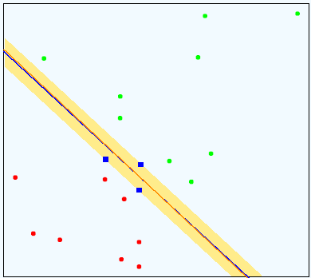
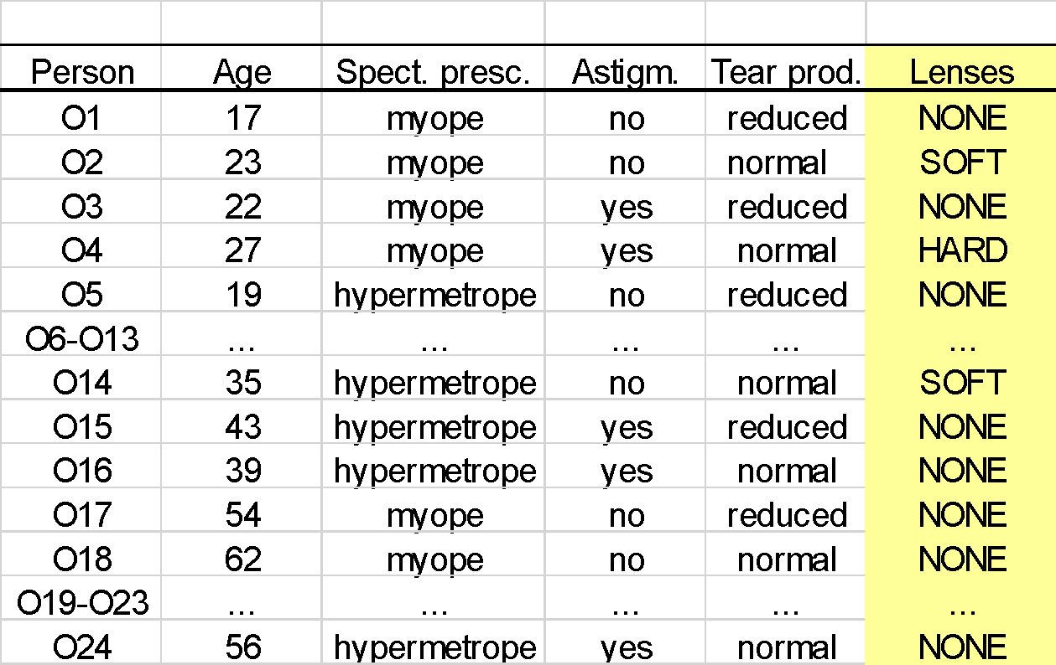
Basics of Machine Learning
5
What is Machine Learning (ML)
  Area of computer science, concerned with the development of computer algorithms that learn from data
Input: Data
Output: Model
ML
Notes:
5

Slide 6
Basics of Machine Learning
6
Origins of terms
  Term Machine learning comes from early AI research in 1960s and 1970s: Perception of learning algorithms as “machines”, able to learn (generalize) from data automatically, without human intervention
  Term Inductive learning refers to the capability of learners to generalize – to automatically induce models from data
  Term Symbolic learning refers to the capability of learners to induce explainable knowledge from data - XAI
Input: Data
Output: Explainable knowledge
ML
Notes:
6

Slide 7
Basics of Machine Learning
7
Two basic learning settings
  Symbolic learning – inducing explainable predictive models, such as decision trees or classification rules
  Sub-symbolic (neural) learning – inducing black-box classifiers, such as neural networks
Input: Data
Output: Model
Symbolic learning
ML
Explainable predictive model
Input: Data
Sub-symbolic learning
ML
Black-box classifier
Notes:
7

Slide 8
Basics of Machine Learning
8
  Early history of symbolic learning algorithms:
  Early rule learning algorithms: AQ (Michalski 1969), …
  Early decision tree learning algorithms since 1970s: ID3 (Quinlan 1979), …
  Early regression tree learners CART (Breiman et al. 1984), …
  Advantage: explainable models, but less accurate classifiers
Sub-symbolic (neural) learning algorithms
  Early perceptron (Rosenblatt 1962), backpropagation neural networks (Rumelhart et al. 1986), …
  Modern deep neural networks (Hinton & Salakhutdinov 2006, Goodfellow et al. 2016), …
  Advantage: more accurate classifiers, but black-box models
Notes:
8

Slide 9
Basics of Machine Learning
9
Learning tasks depend on the type of input data and the goal of learning
  tabular data – prediction and classification, clustering, …
  relational databases – relational learning, inductive logic programming, …
  graphs – network analysis, social network analysis, link prediction, node classification, network completion, …
  texts – text mining, sentiment analysis, hate speech detection, …
  Web pages – Web page recommendation, …
  heterogeneous data and heterogeneous information networks – classification of data instances, node classification, link prediction, …
Notes:
9

Slide 10
Basics of Machine Learning
10
Definition of a standard machine learning task
  Given: class-labeled data set (e.g., transaction data table, relational database, text documents, Web pages, …)
  Find: a classification model, able to predict new instances
Machine Learning
classification model
Notes:
10

Slide 11

Basics of Machine Learning
11
Standard machine learning scenario
  Use a ML algorithm to learn a predictive model from class-labeled data
  Use the induced model to predict the class of new (unlabeled) data instances
new unclassified instance
classified instance
symbolic model explanation
new unclassified instance
classified instance
black box classifier no explanation
Notes:
11

Slide 12

Basics of Machine Learning
Illustrative example: Contact lens data set
12

Slide 13
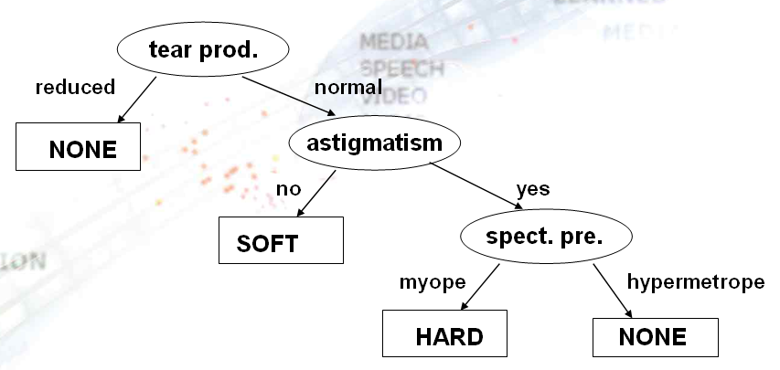

Basics of Machine Learning
Decision tree learning from Contact lens data
13
Data Mining

Slide 14
Basics of Machine Learning
Rule learning from Contact lens data
14
Machine Learning
lenses=NONE ← tear production=reduced
lenses=NONE ← tear production=normal AND astigmatism=yes AND spect. presc.=hypermetrope
lenses=SOFT ← tear production=normal AND astigmatism=no
lenses=HARD ← tear production=normal AND astigmatism=yes AND
spect. presc.=myope
lenses=NONE ←

Slide 15



Basics of Machine Learning
Data Mining
15
data
knowledge discovery from data
Data Mining
patterns
data
  Given: class labeled or non-labeled data
  Find: a set of interesting patterns, explaining the data
IF
Tear prod. = reduced
THEN
Lenses = NONE
symbolic patterns
explanation

Slide 16
Basics of Machine Learning
Pattern discovery from Contact lens data
PATTERN
Rule:
IF
Tear prod. =
reduced
THEN
Lenses =
NONE
16

Slide 17
Basics of Machine Learning
Summary
17
Basic definition of Machine Learning
  Computer algorithms/machines that learn predictive models from class-labeled data
Extended definition of Machine Learning - Used interchangeably with the term Data Mining
  computer algorithms/machines that learn patterns or models from class-labeled or non-labeled data
  sometimes used to denote the practical use of ML techniques applied to solving real-life data analysis problems
Deep Learning - Used in popular literature interchangeably with the term AI ??
Notes:
17

Slide 18
Introduction to Data Mining
18
Basics of Machine Learning
Standard learning tasks
Three generations of machine learning
Advanced learning tasks
Notes:
18

Slide 19
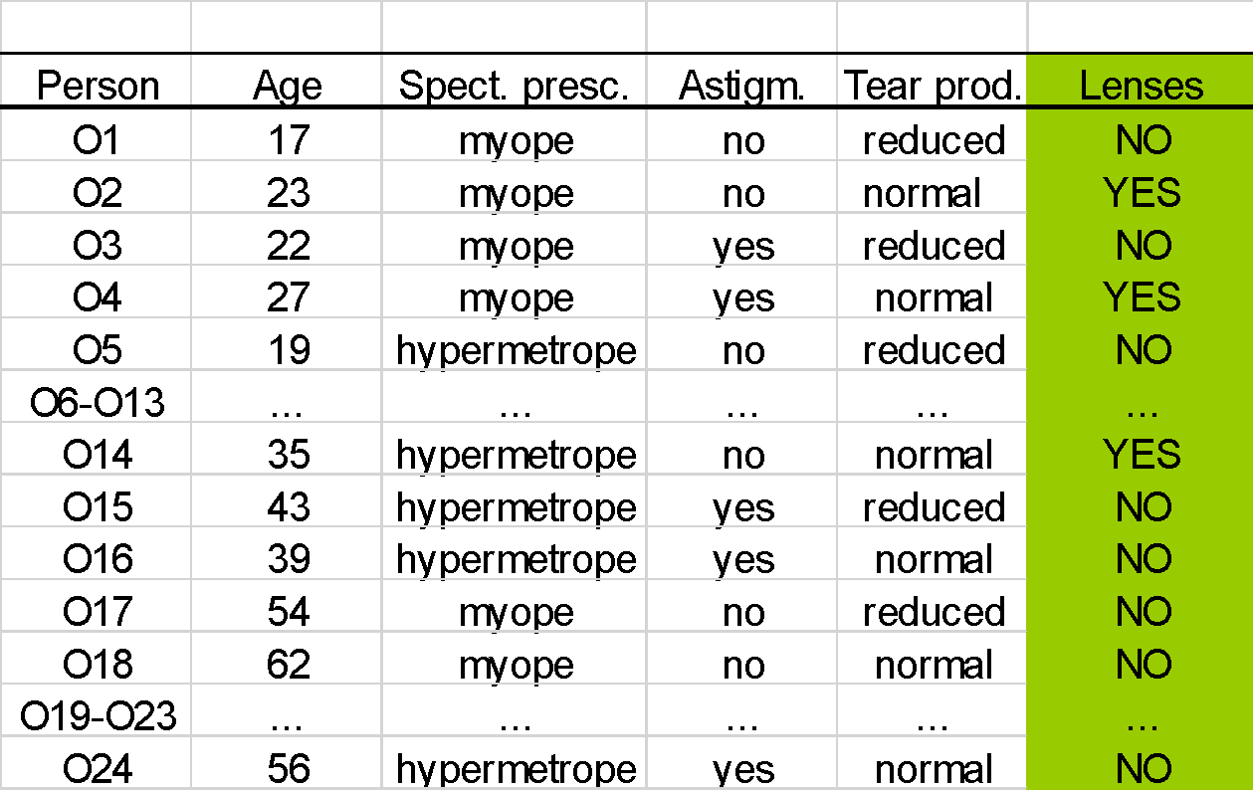
Binary Classification
19
Binary classes
positive vs. negative examples of Target class
Concept learning – binary classification and class description
  - for Subgroup discovery – exploring patterns
  characterizing groups of instances of target class

Slide 20

Multi-class Learning Task
20
Several class labels of training examples of a single Target attribute

Slide 21
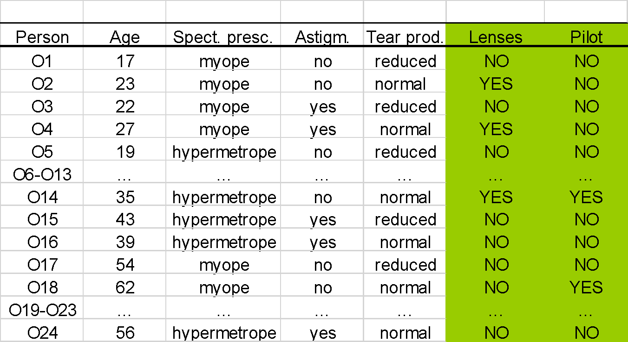
Multi-target Classification
21
Multi target classification
  each example belongs to several Target classes
Notes:
21

Slide 22

Learning from Numeric Class Data
22
Numeric class values – regression analysis

Slide 23
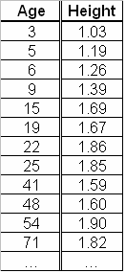
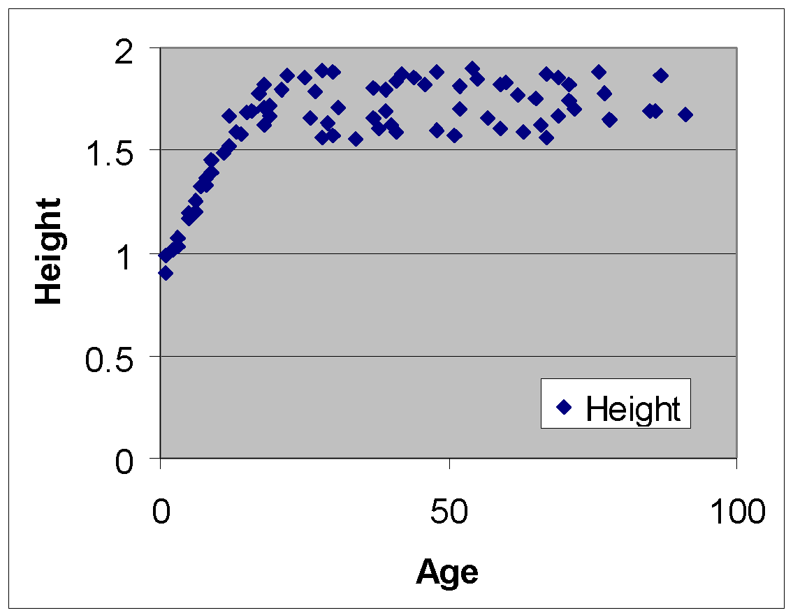
Example regression problem
23
data about 80 people: Age and Height

Slide 24
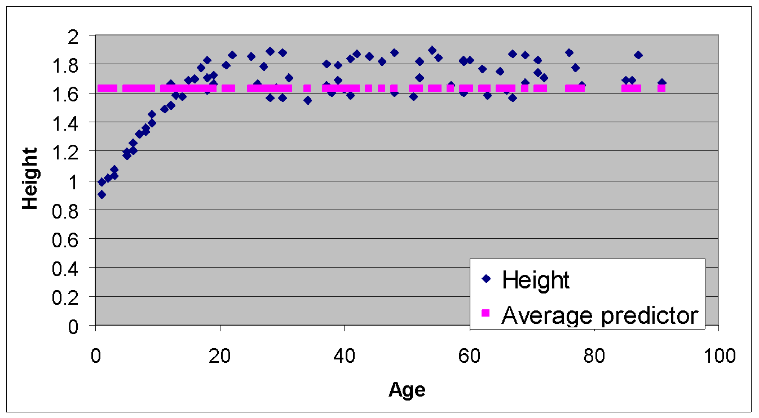
Baseline numeric model
24
Average of the target variable

Slide 25
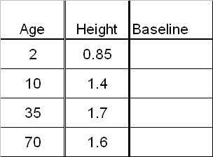
Baseline numeric predictor
25
Average of the target variable is 1.63

Slide 26
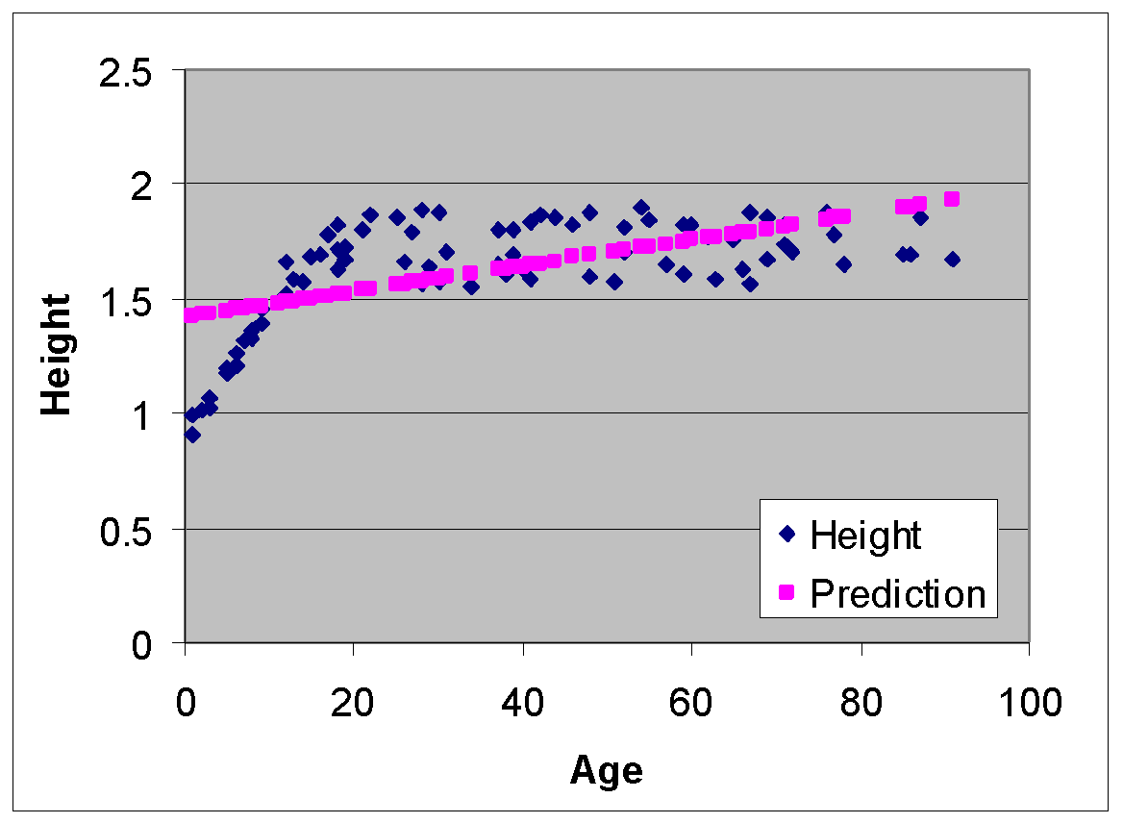
Linear Regression Model
26
Height = 0.0056 * Age + 1.4181

Slide 27
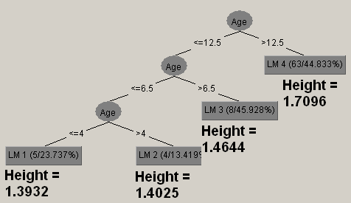
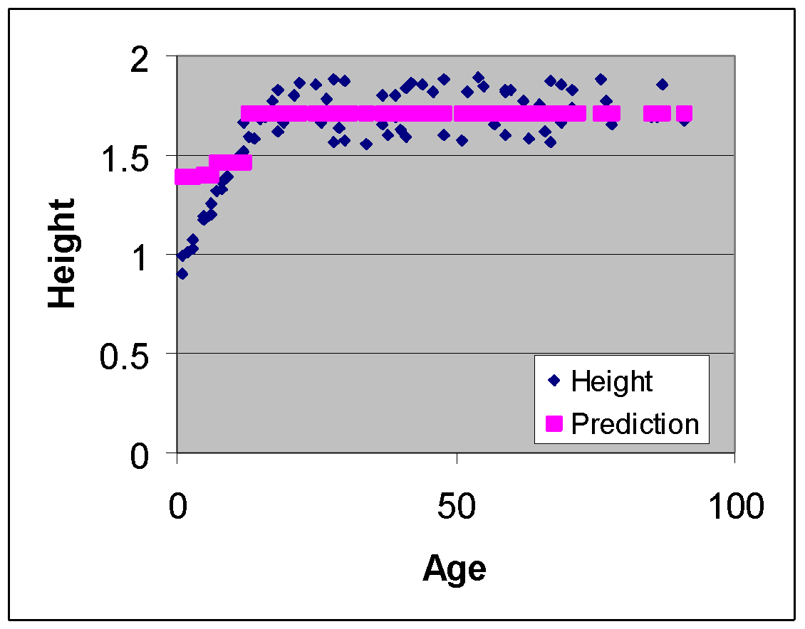
Regression tree
27

Slide 28
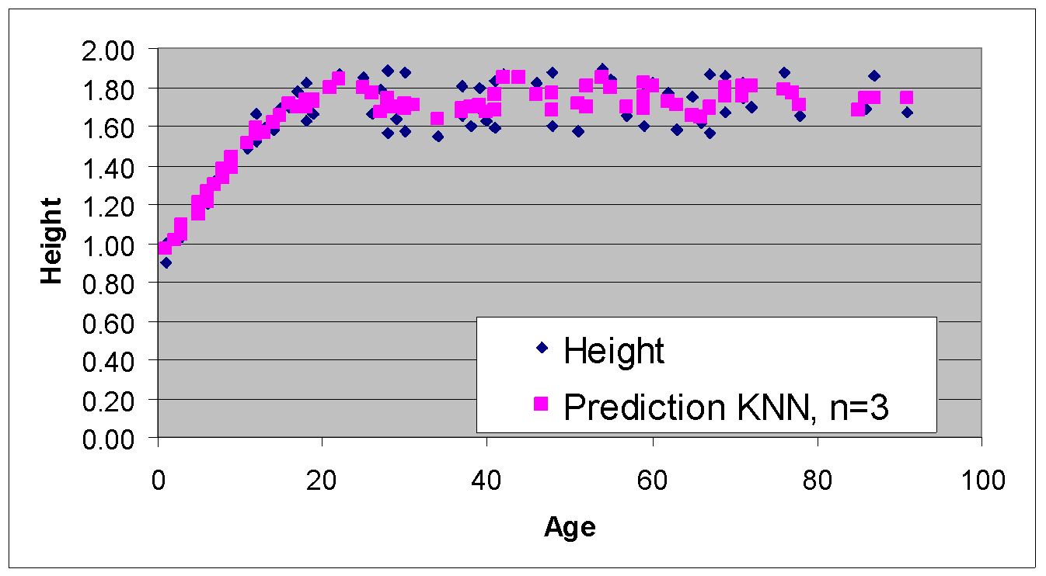
Simple sub-symbolic classifier:
K nearest neighbors (kNN)
28
Looks at K closest examples (by age) and predicts the average of their target variable
K=3

Slide 29
Lesson 1:
Introduction to Data Mining
29
Basics of Machine Learning
Standard learning tasks
Three generations of machine learning
Advanced learning tasks
Notes:
29

Slide 30
First Generation Machine Learning
30
First machine learning algorithms for
  Decision tree and rule learning in 1970s and early 1980s by Quinlan, Michalski et al., Breiman et al., …
Characterized by
  Learning from data stored in a single data table
  Relatively small set of instances and attributes
Lots of ML research followed in 1980s
  Numerous conferences ICML, ECML, … and ML sessions at AI conferences IJCAI, ECAI, AAAI, …
  Extended set of learning tasks and algorithms addressed

Slide 31
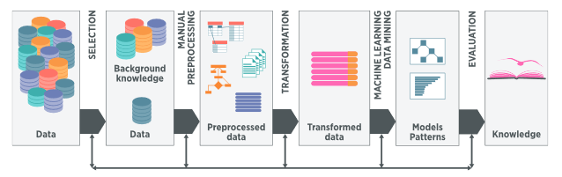
Second Generation Machine Learning
31
Developed since 1990s:
  Focused on data mining tasks characterized by large datasets described by large numbers of attributes
  Addressing the entire process of Knowledge Discovery in Databases (KDD): process understandable models or patterns in data
  Usama M. Fayyad, Gregory Piatesky-Shapiro, Pedhraic Smyth: The KDD Process for
  Extracting Useful Knowledge form Volumes of Data. Comm ACM, Nov 96/Vol 39 No 11
  CRISP-DM methodology
  KDD buzzword since 1996

Slide 32

Second Generation Machine Learning
KDD Process
32
KDD process (CRISP-DM methodology) involves several phases:
  data preparation
  machine learning, data mining, statistics, …
  evaluation and use of discovered patterns
Machine Learning / Data Mining is the key step in the process
  performed using machine learning or pattern mining techniques for extracting classification models or interesting patterns in data
  this key step represents only 15%-25% of entire KDD process

Slide 33
Second Generation Machine Learning
33
  Industrial KDD standard: CRISP-DM methodology (1997)
  New conferences on practical aspects of data mining and knowledge discovery: KDD, PKDD, …
  New learning tasks and efficient learning algorithms:
    Learning descriptive patterns: association rule learning, subgroup discovery, …
    Learning predictive models: Bayesian network learning, Support Vector Machines, relational data mining, …

Slide 34

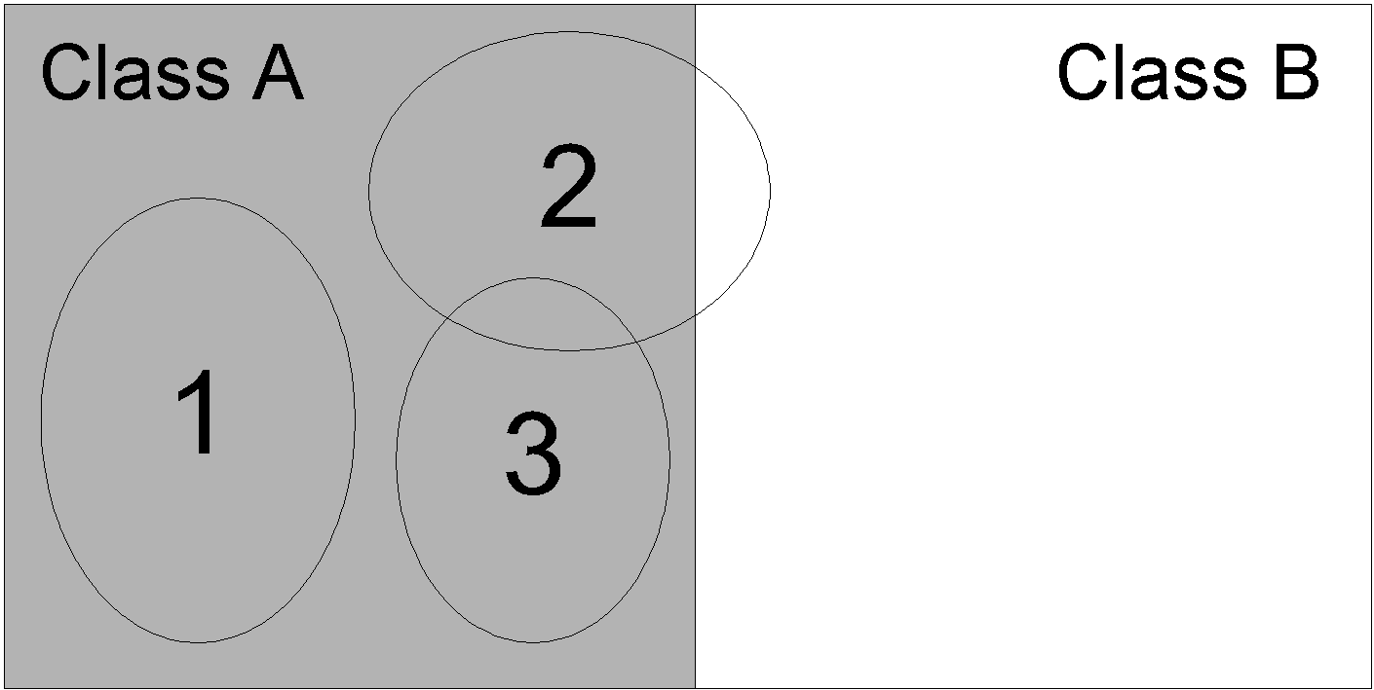
Second Generation Machine Learning
Subgroup Discovery learning task
34
Data transformation:
  binary class values (positive vs. negative examples of Target class)
Subgroup discovery:
  a task in which individual interpretable patterns in the form of rules are induced from data, labeled by a predefined property of interest.
Notes:
34

Slide 35
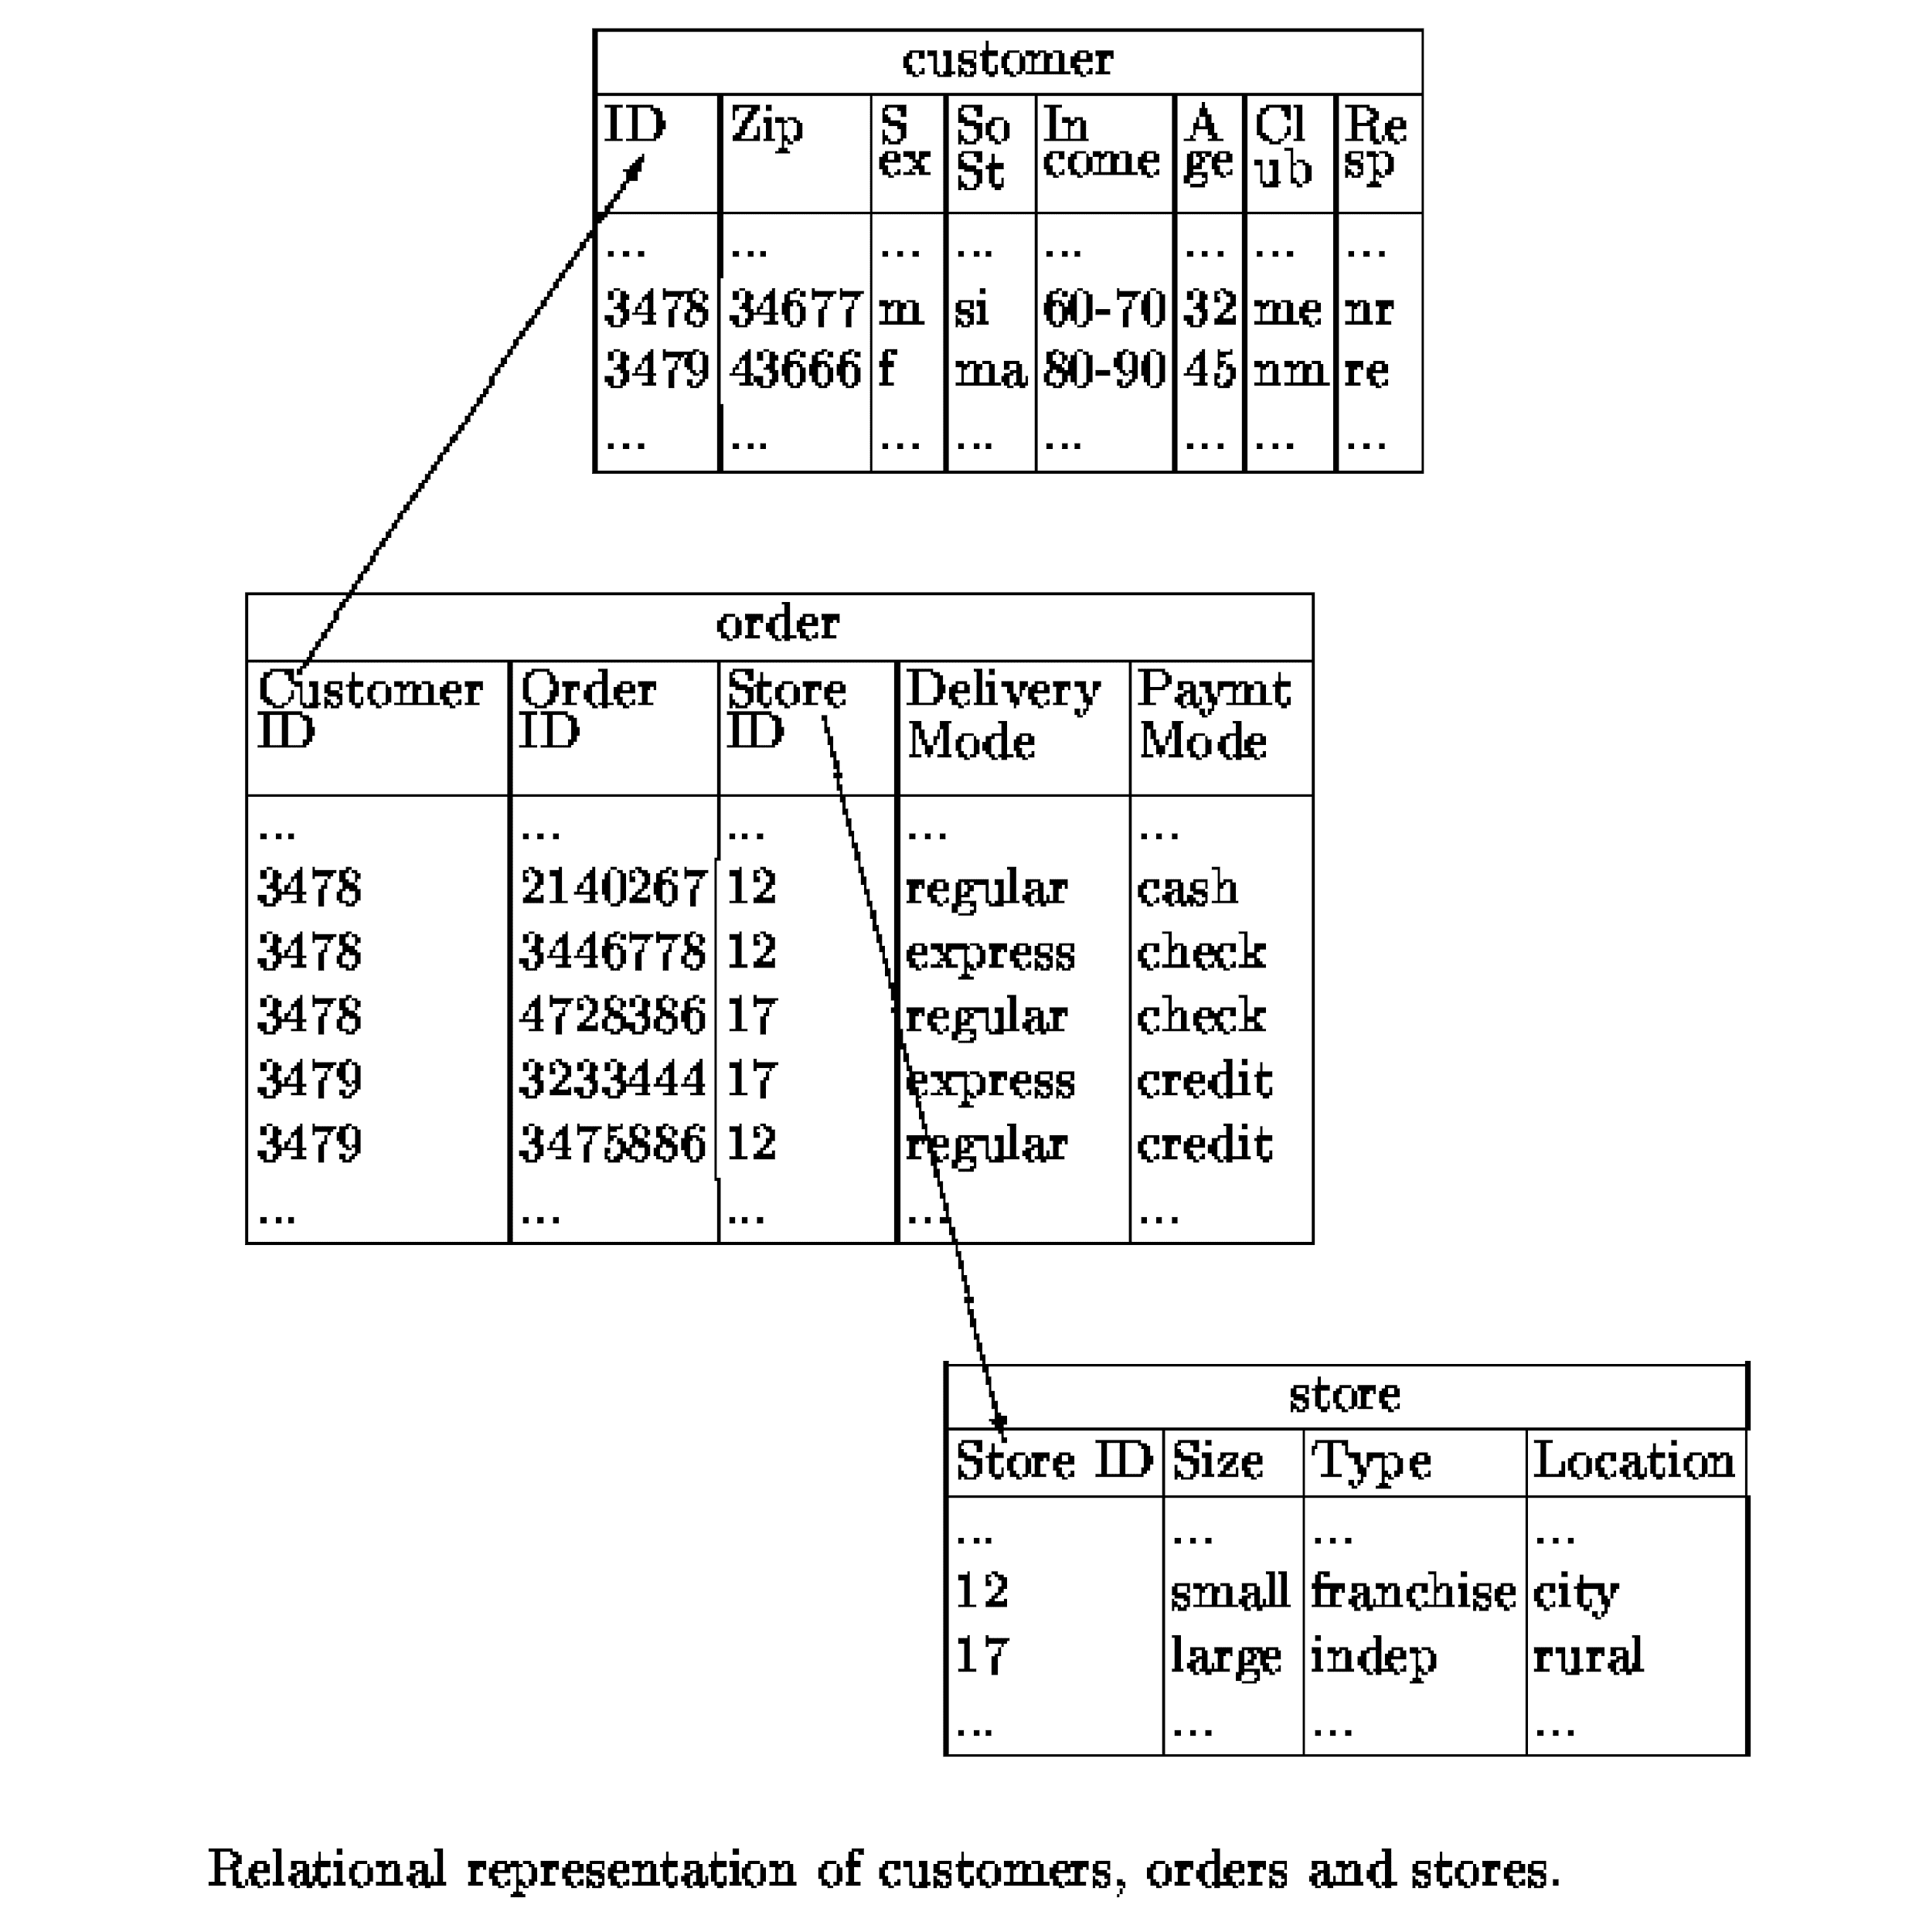
Second Generation Machine Learning
Relational Data Mining task
35
knowledge discovery from data
Relational Data Mining
model, patterns, …
  Given: a relational database, a set of tables, sets of logical
  facts, a graph, …
  Find: a classification model, a set of patterns

Slide 36
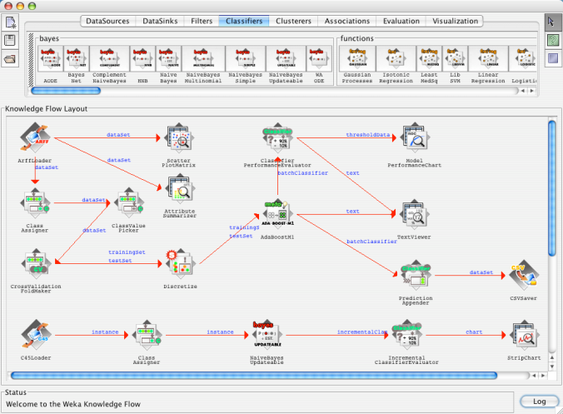
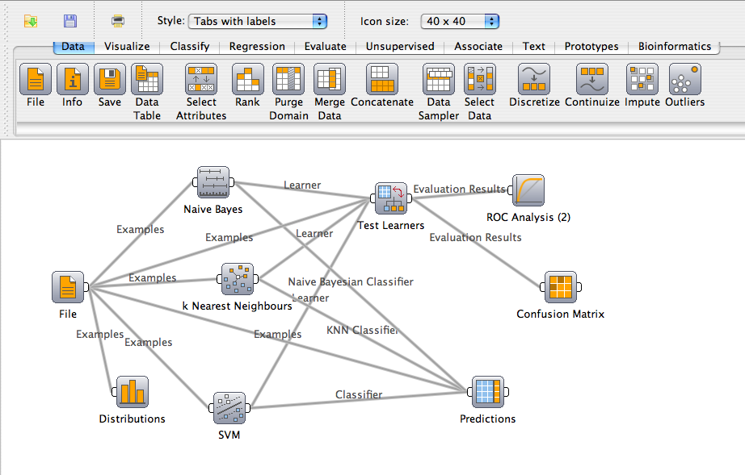
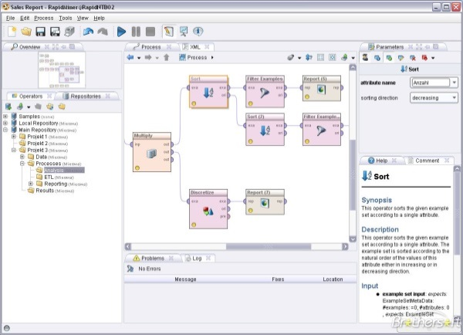
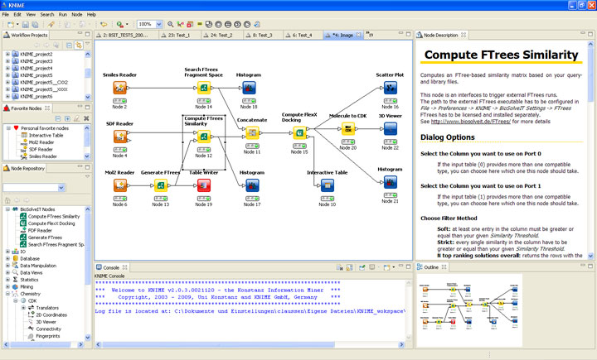
Second Generation Data Mining Platforms
36
Orange, WEKA, KNIME, RapidMiner, …
  include numerous data mining algorithms
  enable data and model visualization
  like Orange, Taverna, WEKA, KNIME, RapidMiner, also enable complex workflow construction

Slide 37
Second Generation Machine Learning
Big Data
37
Big Data – Buzzword since 2008 (special issue of Nature on Big Data)
  data and techniques for dealing with very large volumes of data, possibly dynamic data streams
  requiring large data storage resources, special algorithms for parallel computing architectures.
Notes:
37

Slide 38
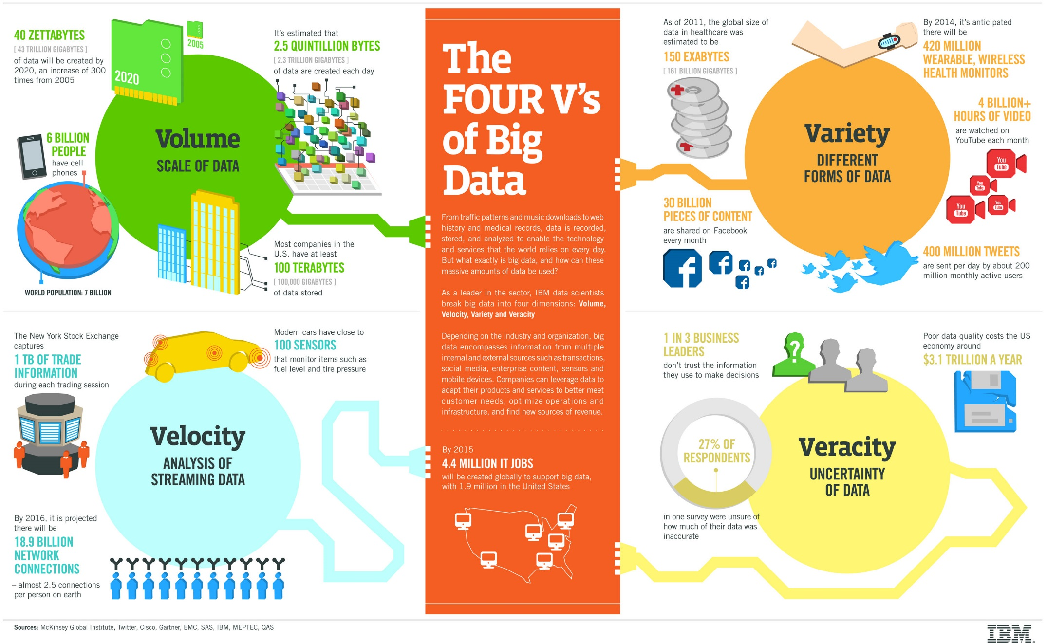
Second Generation Machine Learning
The 4 Vs of Big Data
38

Slide 39
Second Generation Machine Learning
Data Science
39
Data Science – buzzword since 2012 when Harvard Business Review called it "The Sexiest Job of the 21st Century"
  an interdisciplinary field that uses scientific methods, processes, algorithms and systems to extract knowledge and insights from data in various forms, both structured and unstructured, similar to data mining.
  used interchangeably with earlier concepts like business analytics, business intelligence, predictive modeling, and statistics.
Notes:
39

Slide 40

Third Generation Machine Learning
40
Developed since 2010s:
  Focused on big data analytics
  Addressing complex data mining tasks and scenarios
  New conferences on data science and big data analytics; e.g., IEEE Big Data, Complex networks, …
  New learning tasks and efficient learning algorithms:
    Analysis of dynamic data streams, Network analysis, Semantic data mining, Text mining, …
  Lots of emphasis on automated data transformation, i.e. representation learning

Slide 41
Third Generation Machine Learning
Representation learning in the KDD process
Representation learning = Automated data transformation, performed on manually preprocessed data
Data transformation requires handling heterogeneous data
  Data (feature vectors, documents, pictures, data streams, …)
  Background knowledge (multi-relational data tables, networks, text corpora, …)

Slide 42
Current Generation Machine Learning
Automated representation learning without manual data preprocessing
Using pre-trained deep neural networks for handling heterogeneous data
  Data (feature vectors, documents, picture
  Using pre-trained deep neural networks for handling heterogeneous data
Transformer architectures allowing to adapt deep learning models to new tasks
Using open source Large Language Models for handling text data
Machine Learning = AI ?

Slide 43
Lesson 1:
Introduction to Data Mining
43
Basics of Machine Learning
Standard learning tasks
Three generations of machine learning
Advanced learning tasks
Notes:
43

Slide 44
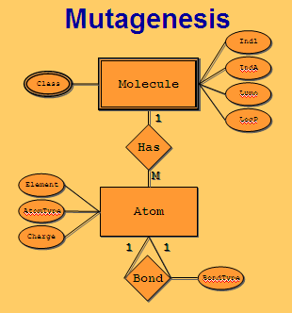
Representation Learning
Relational Data Mining
44
Relational data mining: Learning from complex relational databases
Inductive logic programming: Learning from complex structured data, e.g. molecules and their biochemical properties

Slide 45
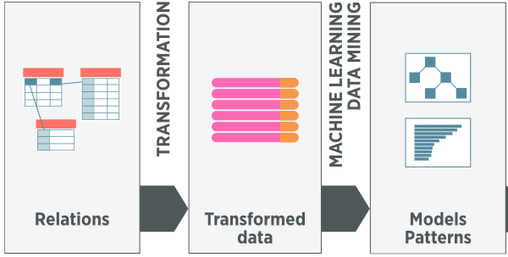
Representation Learning
Relational Data Mining
Representation learning in a relational learning setting:
  automated transformation of multi-relational data
Two main approaches:
  Traditional approach: Propositionalization of relational databases, heterogeneous information networks, …
  Recent approach: Embedding of knowledge graphs, network node embeddings, entity embeddings, …

Slide 46
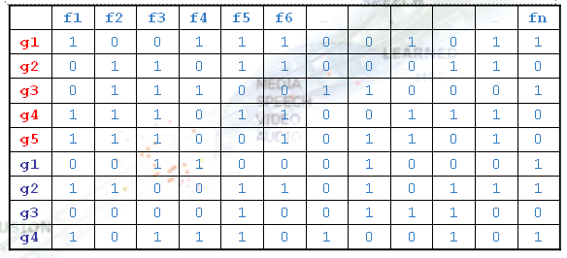
Representation Learning
Relational Data Mining
46
Step 1
Propositionalization
  construct relational features
  construct a propositional table

Slide 47
Representation Learning
Relational Data Mining
47
Step 1
Propositionalization
  construct relational features
  construct a propositional table
Step 2
Machine Learning
classification model

Slide 48
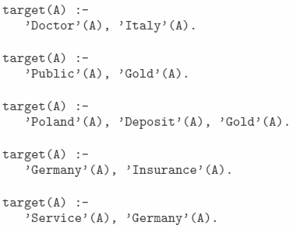
Representation Learning
Relational Data Mining
48
Step 1
Propositionalization
  construct relational features
  construct a propositional table
Step 2
Subgroup discovery
patterns (set of rules)

Slide 49
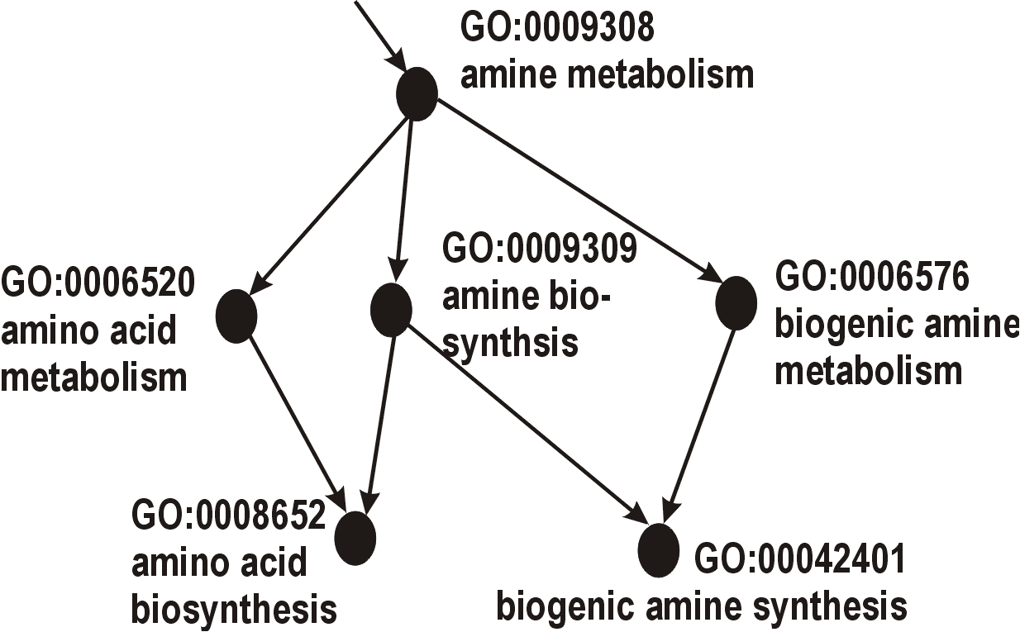
Relational and Semantic Data Mining
49
Relational data mining: Learning from complex relational databases
Inductive logic programming: Learning from complex structured data, e.g. molecules and their biochemical properties
Semantic data mining: Learning by using domain knowledge in the form of ontologies

Slide 50
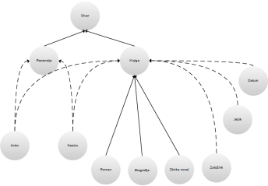
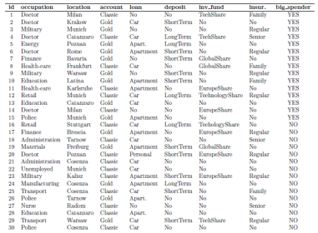
Semantic Data Mining: Using ontologies as background knowledge in RDM
domain ontologies
Semantic
data mining
model,
patterns
annotations,
mappings
  Given:
  transaction data table, relational database, text documents, Web pages, …
  one or more domain ontologies
  Find: a classification model, a set of patterns
data

Slide 51
Using domain ontologies
Using domain ontologies as background knowledge, e.g., using the Gene Ontology (GO)
GO is a database of terms, describing gene sets in terms of their
  functions
  processes
  components
Genes are annotated
  to GO terms
Terms are connected
  (is_a, part_of)
Levels represent
  terms generality
51

Slide 52

Representation Learning
Semantic Data Mining
52
Step 1
Propositionalization
  constructing relational features
  constructing a propositional table
Approach:
  Using relational learning in the SDM context, using a propositionalization approach
Sample application:
  Semantic data mining in a biomedical application by using the Gene Ontology as background knowledge in analyzing microarray data

Slide 53
Text mining: Viewed in propositionalization context: BoW data transformation
BoW vector construction
Step 1
  BoW features construction
  Table of BoW vectors construction
Data Mining
Step 2
model, patterns, clusters, …

Slide 54
BoW construction: Feature weights and Cosine similarity between document vectors
Each document D is represented as a vector of TF-IDF weights
Similarity between two vectors is estimated by the similarity between their vector representations (cosine of the angle between the two vectors):
Similarity between BoW vectors can be used for document clustering, i.e. for finding natural groups of documents in an unsupervised way (no class labels pre-assigned to documents)

Slide 55
Embeddings-based Data Transformation for Text mining
Corpus embedding, Document embedding, Sentence embedding, word embedding (e.g., word2vec)
  Transforming documents by projecting documents into vectors (rows of a data table)

Slide 56
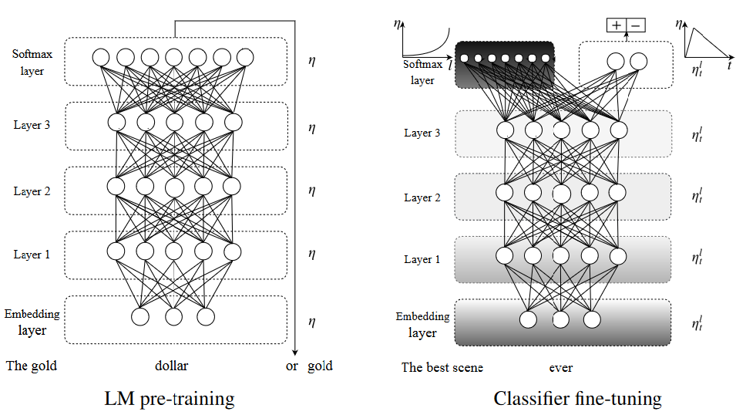
Embeddings-based Data Transformation for Text mining
Corpus embedding, Document embedding, Sentence embedding, word embedding (e.g., word2vec)
  Transforming documents by projecting documents into vectors (rows of a data table)
  Table values correspond to weights in the embedding layer of a neural network

Slide 57
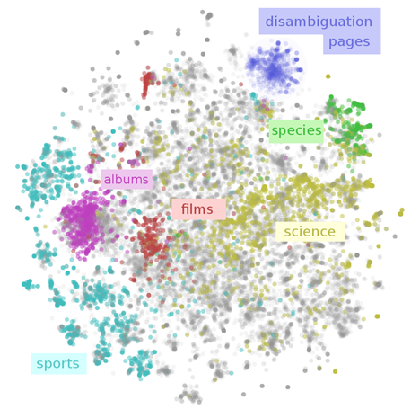
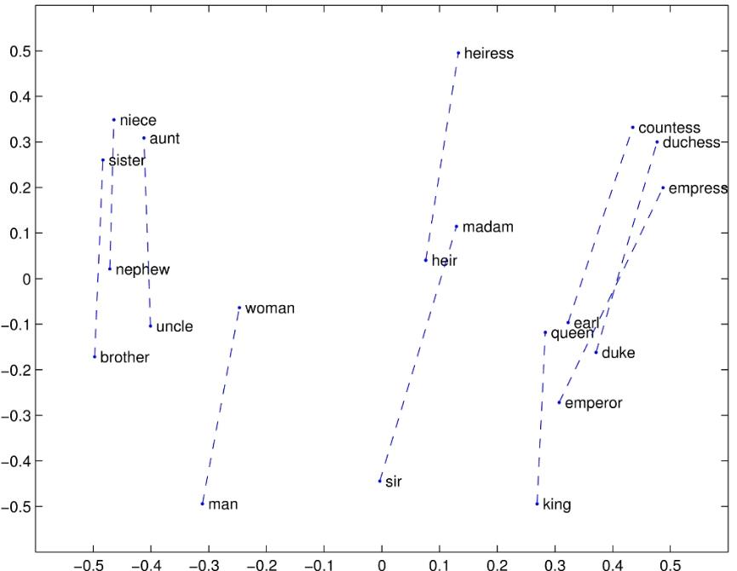
Embedding-based Data Transformation for Text mining
Corpus embedding, Document embedding, Sentence embedding, word embedding, …
  Representations of word meaning obtained from corpus statistics
  Spatial relationships correspond to linguistic relationships

Slide 58
Data Mining Lesson 1:
Summary and Take away messages
58
Motivation for studying Machine Learning
  ML is highly relevant, as motivated by two epidemiology spreading case studies
  Course outline should motivate for studying this modern ML approach to become a skilled data scientist
Introduction to Machine Learning
  ML basics and illustrative examples were presented for elementary classification and regression learning tasks
  Three generations of machine learning and data mining methods were outlined
Representation Learning
  Representation learning is a highly relevant contemporary ML problem
  ML basics and illustrative examples were presented for advanced relational, semantic and text mining tasks

Slide 59
Selected literature
59
James G, Witten D, Hastie T and Tibshirani R (1st Edition 2013, 2nd Edition 2021) An Introduction to Statistical Learning - with Applications in R. Springer, New York. Available at https://statlearning.com/. Chapters 1 and 2.
Bramer M (2007) Principles of Data Mining. Springer, Berlin. DOI:10.1007/978-1-84628-766-4. An introductory textbook for refreshing your knowledge on basics of data mining. The first edition of the textbook is also available at ResearchGate, https://www.researchgate.net/publication/220688376_Principles_of_Data_Mining
Lavrač N, Podpečan V and Robnik-Šikonja M (2021) Representation Learning: Propositionalization and Embeddings. Springer, Berlin. Chapters 1 and 2.
Notes:
59

Slide 60
Lesson 2
Decision tree learning
60
Basic decision tree learning algorithm
Classifier evaluation and decision tree pruning
Selected decision tree learning algorithms
Regression tree learning
Notes:
60

Slide 61
Decision tree learning: an illustrative example
61
Machine learning

Slide 62
Predictive DM task: Basic notions
Data are objects, characterized with attributes A_{i} and class-labels C_{j}
Objects (data instances, training examples) are described with attribute values
Attributes can be discrete, nominal or numeric
Classes can be discrete (binary classification) or nominal (multi-class learning) or numeric (regression)
Classification learning task is to induce a model capable to predict the class-label for a new (unclassified) instance

Slide 63
TDIDT - Decision tree learning algorithm
Elementary decision tree learning algorithm ID3 (Quinlan 1979)
  create the root node of the tree
  if all examples from S belong to the same class C_{j}
    then label the root with C_{j}
  else
    select the ‘most informative’ attribute A with values v₁, v₂, … v_{n}
    divide training set S into S₁,… , S_{n} according to values v₁, v₂, … v_{n}
    recursively build sub-trees
    T₁,… , T_{n} for S₁,… , S_{n}
A
v₁
v_{n}
...
T₁
...
T_{n}

Slide 64
Decision tree search heuristics
Central choice in decision tree algorithms: Which attribute to test at each node in the tree ? The attribute that is most useful for classifying examples.
Define a statistical property, called information gain, measuring how well a given attribute separates the training examples w.r.t their target classification.
First define a measure commonly used in information theory, called entropy, to characterize the (im)purity of an arbitrary collection of examples.

Slide 65
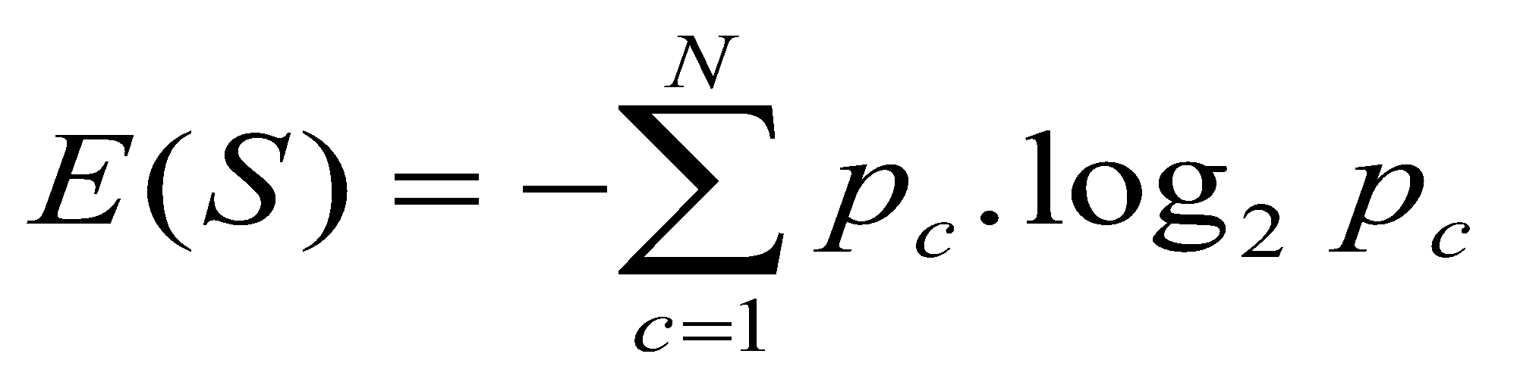
Entropy
65
Entropy E(S) – measure of impurity of training set S
In concept learning (binary classification) problems, with training set S labeled by two classes C₊ and C₋
In multi-class learning problems, with training set S labeled by N classes C₁,C₂...,C_{N}
E(S) = - p₊ log₂ p₊ - p₋ log₂ p₋
p₊ - prior probability of class C₊ (relative frequency of C₊ in S)
p₋ - prior probability of class C₋
p_{c} - prior probability of class C_{c} (relative frequency of C_{c} in S)

Slide 66
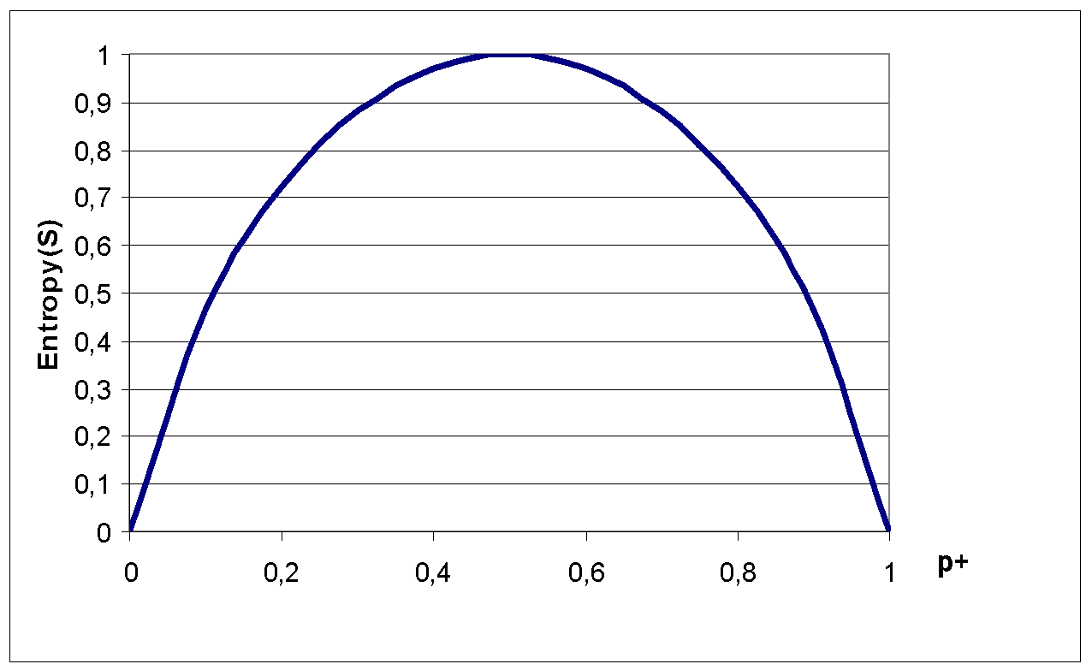
Entropy
66
E(S) = - p₊ log₂p₊ - p₋ log₂p₋
The entropy function relative to a Boolean classification, as the proportion p₊ of positive examples varies between 0 and 1

Slide 67
Entropy – why ?
Entropy E(S) = expected amount of information (in bits) needed to assign a class to a randomly drawn object in S (under the optimal, shortest-length code)
Why ?
Information theory: optimal length code assigns - log₂p bits to a message having probability p
So, in binary classification problems, the expected number of bits to encode + or – of a random member of S is:
p₊ ( - log₂p₊ ) + p₋ ( - log₂p₋ ) = - p₊ log₂p₊ - p₋ log₂p₋

Slide 68
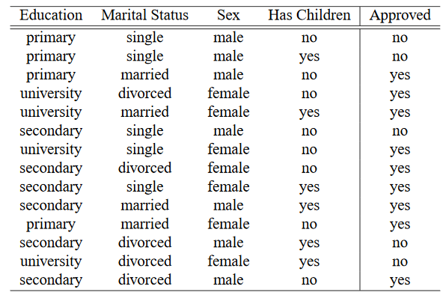
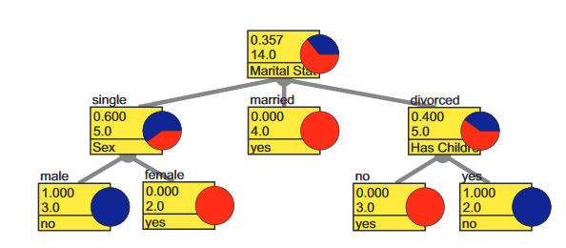
Binary classification problem:
Survey data

Slide 69
Entropy – example calculation
Training set S: 14 examples (9 pos., 5 neg.)
Notation: S = [9+, 5-]
E(S) = - p₊ log₂p₊ - p₋ log₂p₋
Computing entropy, if probability is estimated by relative frequency
E([9+,5-]) = - (9/14) log₂(9/14) - (5/14) log₂(5/14) = 0.940

Slide 70
Survey data: Entropy
E(S) = - p₊ log₂p₊ - p₋ log₂p₋
E([9+,5-]) = - (9/14) log₂(9/14) - (5/14) log₂(5/14) = 0.940
single
{e1,e2,e6,e7,e9} [2+, 3-] E=0.970
Marital status ?
married
{e3,e5,e10,e11} [4+, 0-] E=0
divorced
{e4,e8,e12,e13, e14} [3+, 2-] E=0.970
male
[3+, 4-] E=0.985
Sex ?
female
[6+, 1-] E=0.592
no
[6+, 2-] E=0.811
Has children ?
yes
[3+, 3-] E=1.00

Slide 71
Information gain search heuristic
Information gain measure is aimed to minimize the number of tests needed for the classification of a new object
Gain(S,A) – expected reduction in entropy of S due to sorting on A
Most informative attribute: max Gain(S,A)

Slide 72
Information gain search heuristic
Which attribute is more informative, A1 or A2 ?
Gain(S,A1) = 0.94 – (8/14 x 0.811 + 6/14 x 1.00) = 0.048
Gain(S,A2) = 0.94 – 0 = 0.94 A2 has max Gain
[9+,5−], Ε = 0.94
[9+,5−], Ε = 0.94
Α1
Α2
[6+, 2−]
[3+, 3−]
[9+, 0−]
[0+, 5−]
Ε=0.811
Ε=1.00
Ε=0.0
Ε=0.0

Slide 73
Survey data: Information gain
Values(Has children) = {no, yes}
  S = [9+,5-], E(S) = 0.940
  S_{no} = [6+,2-], E(S_{no} ) = 0.811
  S_{yes} = [3+,3-], E(S_{yes} ) = 1.0
  Gain(S, Has children) = E(S) - (8/14)E(S_{no}) - (6/14)E(S_{yes}) = 0.940 - (8/14)x0.811 - (6/14)x1.0=0.048
no
[6+, 2-] E=0.811
Has children ?
yes
[3+, 3-] E=1.00

Slide 74
Survey data: Information gain
Which attribute is the best?
  Gain(S, Marital status)=0.246 MAX !
  Gain(S, Sex)=0.151
  Gain(S, Has children)=0.048
  Gain(S, Education)=0.029

Slide 75
Survey data: Information gain
Marital
status ?
single
{D4,D5,D6,D10,D14} [3+, 2-] E=0.970 ???
married
{D3,D7,D12,D13} [4+, 0-] E = 0 OK - assign class Yes
divorced
{D1,D2,D8,D9,D11} [2+, 3-] E=0.970 ???
Which attribute should be tested here?
  Gain(S_{divorced}, Sex) = 0.97-(3/5)0-(2/5)0 = 0.970 MAX !
  Gain(S_{divorced},Has children) = 0.97-(2/5)0-(2/5)1-(1/5)0 = 0.570
  Gain(S_{divorced},Education) = 0.97-(2/5)1-(3/5)0.918 = 0.019

Slide 76
Alternative probability estimates
Relative frequency :
  Computed as |S+ | / |S|
  problems with small samples
Laplace estimate :
  assumes uniform prior distribution of k classes
  For k=2, Computed as (|S+ |+1) / (|S|+2)
[6+,1-] (7) = 6/7
[2+,0-] (2) = 2/2 = 1
[6+,1-] (7) = (6+1) / (7+2) = 7/9
[2+,0-] (2) = (2+1) / (2+2) = 3/4

Slide 77
Heuristic search in ID3
Search bias: Search the space of decision trees from simplest to increasingly complex (top-down greedy search, no backtracking, prefer small trees)
Search heuristics: At a node, select the attribute that is most useful for classifying examples, split the node accordingly
Stopping criteria: A node becomes a leaf
  if all examples belong to same class C_{j}, label the leaf with C_{j}
  if all attributes were used, label the leaf with the most common value C_{k} of examples in the node
Extension to ID3: handling noise - tree pruning

Slide 78
Decision tree learning
78
Basic decision tree learning algorithm
Classifier evaluation and decision tree pruning
Selected decision tree learning algorithms
Regression tree learning
Notes:
78

Slide 79
Classifier evaluation
Evaluation of learned models
  discovery of new patterns, new knowledge
  explainability and compactness - XAI
  information contents (information score) - significance
  classification of new objects – accuracy
Evaluating the accuracy of learned models
  Accuracy, Error = 1 – Accuracy
  high accuracy on testing examples = high percentage of correctly classified unseen instances – high predictive power
  high accuracy on training examples – possible data overfitting

Slide 80
Classifier evaluation
Evaluation methodology
  split the example set into training set (e.g. 70%) to induce a concept, and test set (e.g. 30%) to test its accuracy
  more elaborate strategies: 10-fold cross validation, leave-one-out, ...
N-fold cross-validation method for accuracy estimation of classifiers
  Partition set D into n disjoint, almost equally-sized folds T_{i} where U_{i} T_{i} = D
  for i = 1, ..., n do
    form a training set out of n-1 folds: Di = D\T_{i}
    induce classifier H_{i} from examples in Di
    use fold T_{i} for testing the accuracy of H_{i}
  Estimate the accuracy of the classifier by averaging accuracies over 10 folds T_{i}

Slide 81
Overfitting and accuracy
Typical relation between tree size and accuracy
Question: how to prune optimally?

Slide 82
Pruning of decision trees
Avoid overfitting the data by tree pruning
Pruned trees are
  less accurate on training data
  more accurate when classifying unseen data

Slide 83
Handling noise – Tree pruning
Sources of imperfection
  1. Random errors (noise) in training examples
    erroneous attribute values
    erroneous classification
  2. Too sparse training examples (incompleteness)
  3. Inappropriate/insufficient set of attributes (inexactness)
  4. Missing attribute values in training examples

Slide 84
Handling noise – Tree pruning
Handling imperfect data
  handling imperfections of type 1-3
    pre-pruning (stopping criteria)
    post-pruning / rule truncation
  handling missing values
Pruning avoids perfectly fitting noisy data: relaxing the completeness (fitting all +) and consistency (not fitting all -) criteria in ID3

Slide 85
Prediction of breast cancer recurrence: Tree pruning
Degree_of_malig
< 3
≥ 3
Tumor_size
Involved_nodes
< 15
≥ 15
< 3
≥ 3
Age
no_recur 125
recurrence 39
no_recur 30
recurrence 18
no_recur 27
recurrence 10
< 40
≥40
no_recur 4
recurrence 1
no_recur 4
no_rec 4 rec1

Slide 86
Pruned decision tree for contact lenses recommendation
tear prod.
reduced
normal
NONE
astigmatism
no
yes
[N=12,S+H=0]
SOFT
spect. pre.
myope
hypermetrope
[S=5,H+N=1]
HARD
NONE
[H=3,S+N=2]
[N=2, S+H=1]

Slide 87
Decision tree learning
87
Basic decision tree learning algorithm
Classifier evaluation and decision tree pruning
Selected decision tree learning algorithms
Regression tree learning
Notes:
87

Slide 88
Selected decision/regression tree learners
Decision tree learners
  ID3 (Quinlan 1979)
  CART (Breiman et al. 1984)
  Assistant (Cestnik et al. 1987)
  C4.5 (Quinlan 1993), C5 (See5, Quinlan)
  J48 (available in WEKA), Tree (in Orange)
Regression tree learners, model tree learners
  M5, M5P (implemented in WEKA), Tree (in Orange)

Slide 89
Appropriate problems for decision tree learning
Classification problems: classify an instance into one of a discrete set of possible categories (medical diagnosis, classifying loan applicants, …)
Characteristics:
  instances described by attribute-value pairs
  (discrete or real-valued attributes)
  target function has discrete output values
  (boolean or multi-valued, if real-valued then regression trees)
  disjunctive hypothesis may be required
  training data may be noisy (classification errors and/or errors in attribute values)
  training data may contain missing attribute values

Slide 90
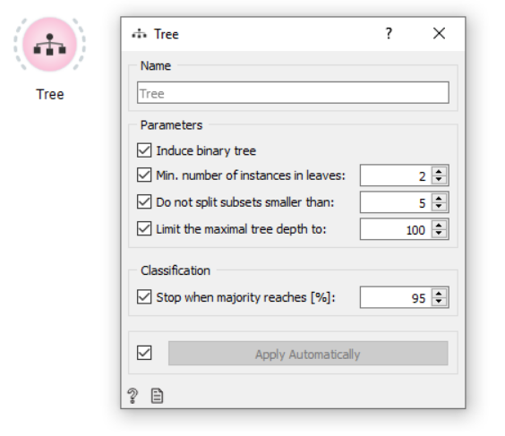
Selected decision tree learners
Decision tree learners: Tree (in Orange)

Slide 91
Decision tree learning
91
Basic decision tree learning algorithm
Classifier evaluation and decision tree pruning
Selected decision tree learning algorithms
Regression tree learning
Notes:
91

Slide 92
Regression tree learning
Estimation or regression task: given objects described with attribute values, induce a model to predict the numeric class value
Data are objects, characterized with attributes (discrete or continuous), classes of objects are continuous (numeric)
Regression tree learners, model tree learners:
  M5
  M5P (implemented in WEKA)
  Tree (in Orange)

Slide 93
Regression tree
93

Slide 94
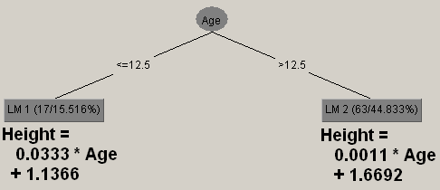
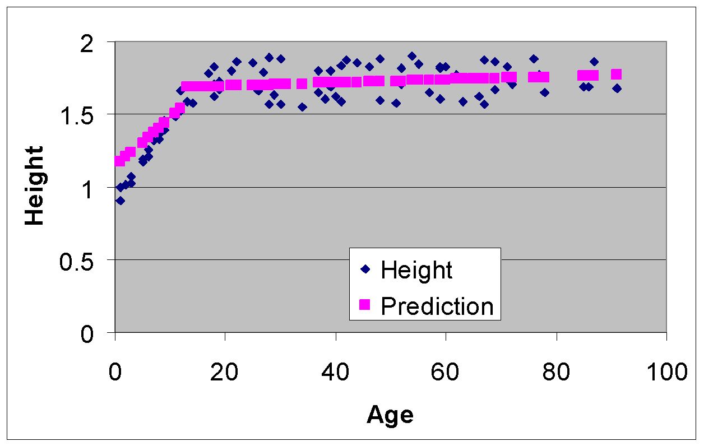
Model tree
94

Slide 95
Predicting algal biomass: regression tree
Month
Jan.-June
July - Dec.
Ptot
Si
≤ 9.34
> 9.34
≤ 10.1
>10.1
Ptot
4.32±2.07
Ptot
2.34±1.65
≤ 5.9
> 5.9
≤ 9.1
> 9.1
Si
1.28±1.08
2.97±1.09
2.08 ±0.71
≤ 2.13
> 2.13
1.15±0.21
0.70±0.34

Slide 96
Regression learners:
Which predictor is the best?

Slide 97
Regression | Classification
Data: attribute-value description
Target variable: Continuous | Target variable: Categorical (nominal)
Evaluation: cross validation, separate test set, …
Error: MSE, MAE, RMSE, … | Error: 1-accuracy
Algorithms: Linear regression, regression trees,… | Algorithms: Decision trees, Naïve Bayes, …
Baseline predictor: Mean of the target variable | Baseline predictor: Majority class

Slide 98
Lesson 2
Summary and Take away messages
98
Decision tree learning
  Addresses classification problems
  Algorithms use search heuristics to search the space of possible trees in a top-down manner
  Training data may be noisy - tree pruning help dealing with noisy data to improve predictive accuracy on new, unlabeled data
Regression tree learning
  Addresses predictive modeling from numeric data
  Advanced regression tree and model tree learners exist
Notice different evaluation criteria for classification and regression

Slide 99
Lesson 3:
Rule Learning
99
Transforming decision trees to rules
Classification rule learning algorithm
  Covering algorithm
  Learning individual rules
Association rule learning
Notes:
99

Slide 100
Converting decision tree to rules, and rule post-pruning (Quinlan 1993)
100
Very frequently used method, e.g., in C4.5 and J48
Procedure:
  grow a full tree (allowing overfitting)
  convert the tree to an equivalent set of rules
  prune each rule independently of others
  sort final rules into a desired sequence for use

Slide 101
Learning decision trees
Survey data
101

Slide 102
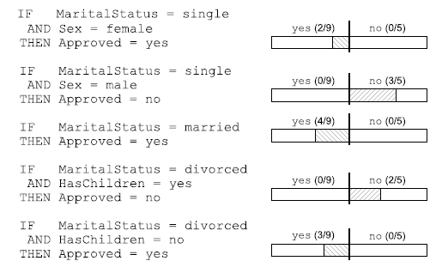
Transforming trees to rules:
Survey data
102

Slide 103

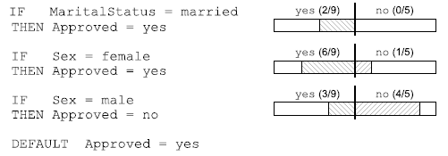
Pruning classification rules:
Survey data
103

Slide 104
Lesson 3:
Rule Learning
104
Transforming decision trees to rules
Classification rule learning algorithm
  Covering algorithm
  Learning individual rules
Association rule learning
Notes:
104

Slide 105
Covering algorithm for binary classification problems (AQ, Michalski 1969,86)
105
Given examples of 2 classes C1, C2
for each class Ci do
  RuleBase(Ci) := empty
  repeat {learn-set-of-rules}
    E_{cur} := Pi U Ni (Pi pos., Ni neg.)
    learn-one-rule R covering some positive and no negatives examples
    add R_{cur} to RuleBase(Ci)
    Pi = delete from Pi all pos. ex. covered by R
  until Pi = empty
+
+
-
-
-
+
+
+
-
+
+
-
-

Slide 106
Covering algorithm
106
Positive examples
Negative examples
+
+
+
-
-
-
+
+
+
+
-
-
-
-
+
+
+
+
-
-
-
-
+
+
+
-
-
-
+
+
-
-
+
+
+
-
-
-
+
+
+
-
-
-
+
-

Slide 107
Covering algorithm
107
Rule1: Cl=+ ← Cond2 AND Cond3
Positive examples
Negative examples
+
+
+
-
-
-
+
+
+
+
-
-
-
-
+
+
+
+
-
-
-
-
+
+
+
-
-
-
+
+
-
-
+
+
+
-
-
-
+
+
+
-
-
-
+
-

Slide 108
Covering algorithm
108
Rule1: Cl=+ ← Cond2 AND Cond3
Positive examples
Negative examples
-
-
-
+
-
-
-
-
+
+
+
+
-
-
-
-
+
+
+
-
-
-
+
+
-
-
+
+
+
-
-
-
+
+
+
-
-
-
+
-

Slide 109
Covering algorithm
109
Rule1: Cl=+ ← Cond2 AND Cond3
Positive examples
Negative examples
-
-
-
-
-
-
-
+
-
-
-
-
+
-
-
-
+
-
-
+
-
-
-
+
+
-
-
-
+
-
Rule2: Cl=+ ← Cond8 AND Cond6

Slide 110
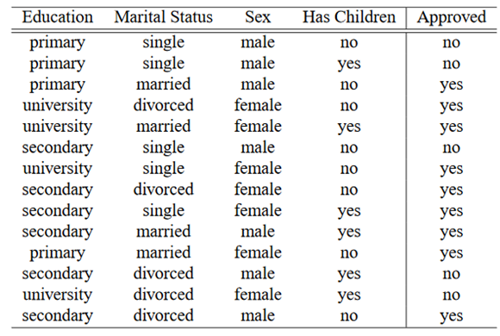
Principles of learning classification rules
110
Important notions:
Rules are learned separately for each class
(e.g., separately for two classes: Yes and No)
Aiming at large “coverage” of the target class
  Large coverage of class Yes when learning rules for class Yes
  Large coverage of class No when learning rules for class No
Default (majority class) rule is added when coverage becomes low (below some user-defined rule pruning parameter)

Slide 111
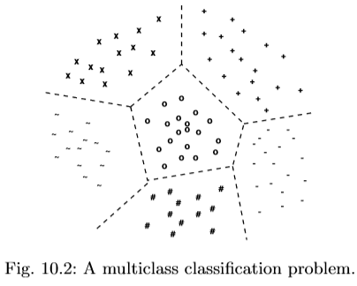
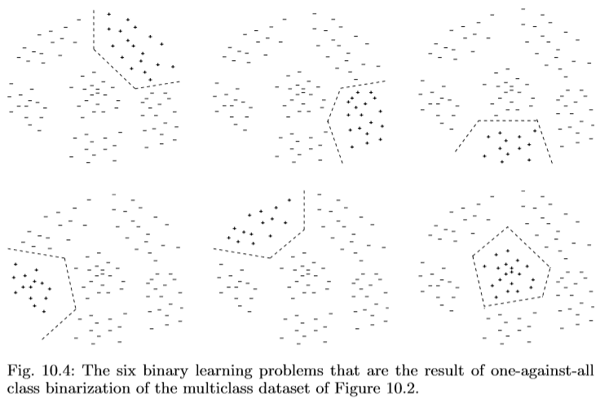
Multi-class learning:
One-against-all learning strategy
111

Slide 112
Learn-one-rule:
Search mechanism and heuristics
112
Assume a two-class problem
Two classes (+,-), learn rules for + class (Cl)
Search for specializations R’ of a rule R = Cl ← Cond from the RuleBase
Specialization R’ of rule R = Cl ← Cond
has the form R’ = Cl ← Cond & Cond’
Heuristic search for rules: find the best Cond’ to be added to the current rule R, such that rule accuracy is improved, e.g., such that Acc(R’) > Acc(R)
  where the expected accuracy (precision) of a rule can be estimated as A(R) = p(Cl|Cond)

Slide 113
Learn-one-rule as heuristic search:
Survey data
113
Approved = yes ←
...
Approved = yes ←
Has children = no
Approved = yes ←
Sex = male
Approved = yes ←
Has children = yes
Approved = yes ←
Sex = female
Approved = yes ←
Sex = female
Has children = no
Approved = yes ←
Sex = female
Marital status=divorced
Approved = yes ←
Sex = female
Has children = yes
Approved = yes ←
Sex = female
Marital status = single

Slide 114
Learn-one-rule as heuristic search:
Survey data
114
Approved = yes ←
[9+,5−] (14)
...
Approved = yes ←
Has children = no
Approved = yes ←
Sex = male
[6+,2−] (8)
Approved = yes ←
Has children = yes
Approved = yes ←
Sex = female
[3+,4−] (7)
[3+,3−] (6)
[6+,1−] (7)
Approved = yes ←
Sex = female
Has children = no
Approved = yes ←
Sex = female
Marital status=divorced
Approved = yes ←
Sex = female
Has children = yes
Approved = yes ←
Sex = female
Marital status = single
[2+,0−] (2)

Slide 115
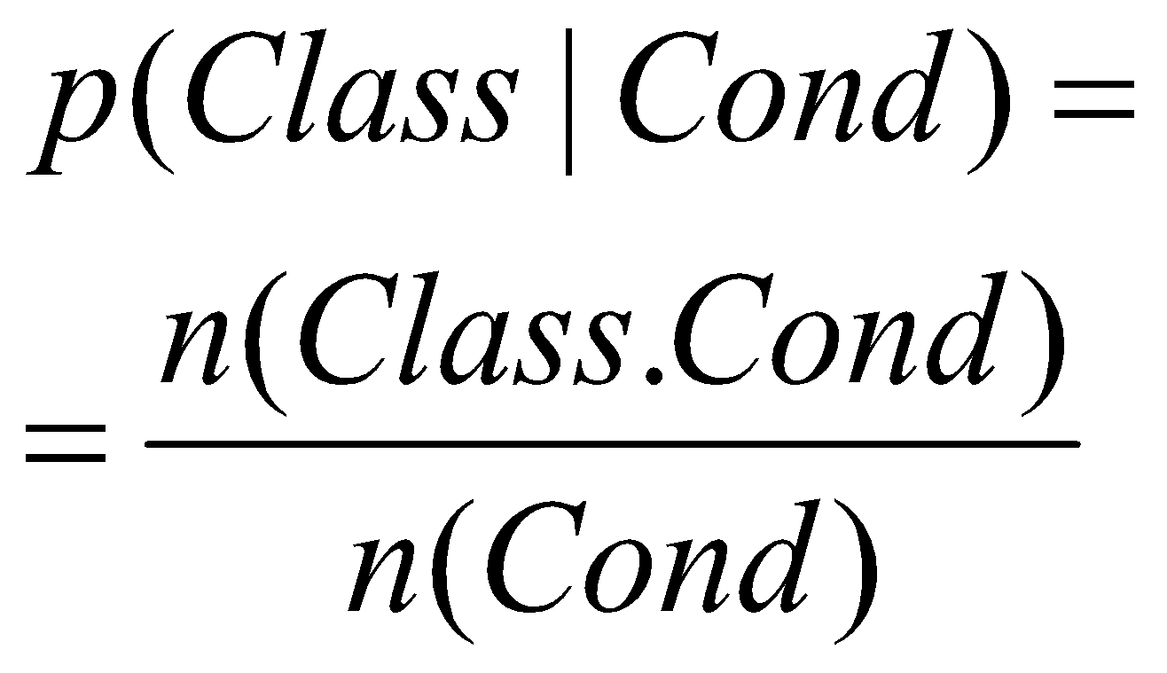
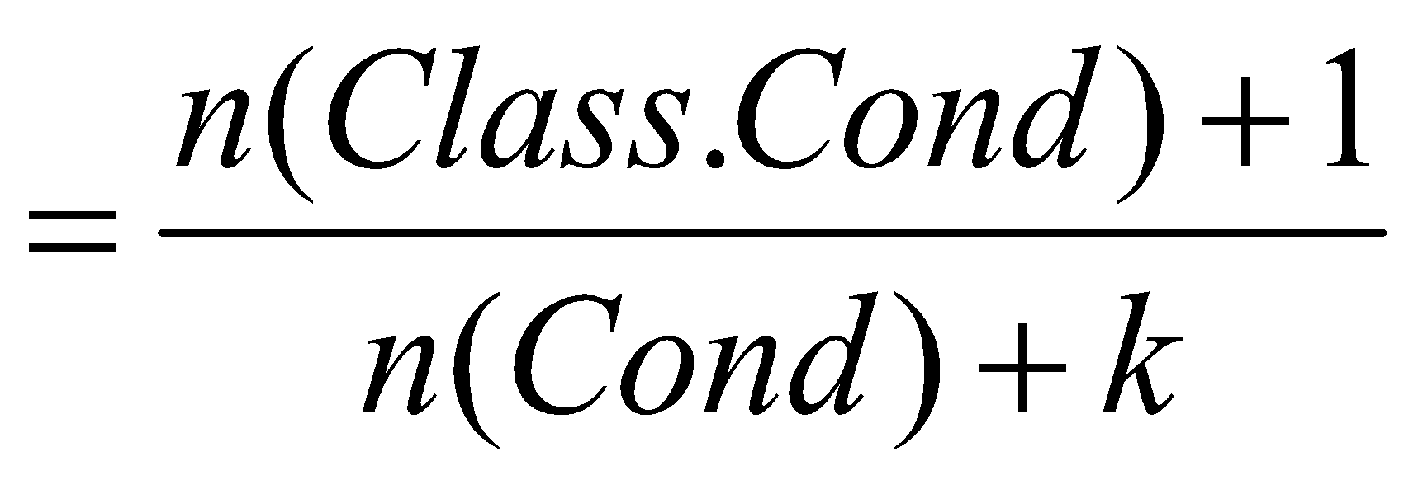
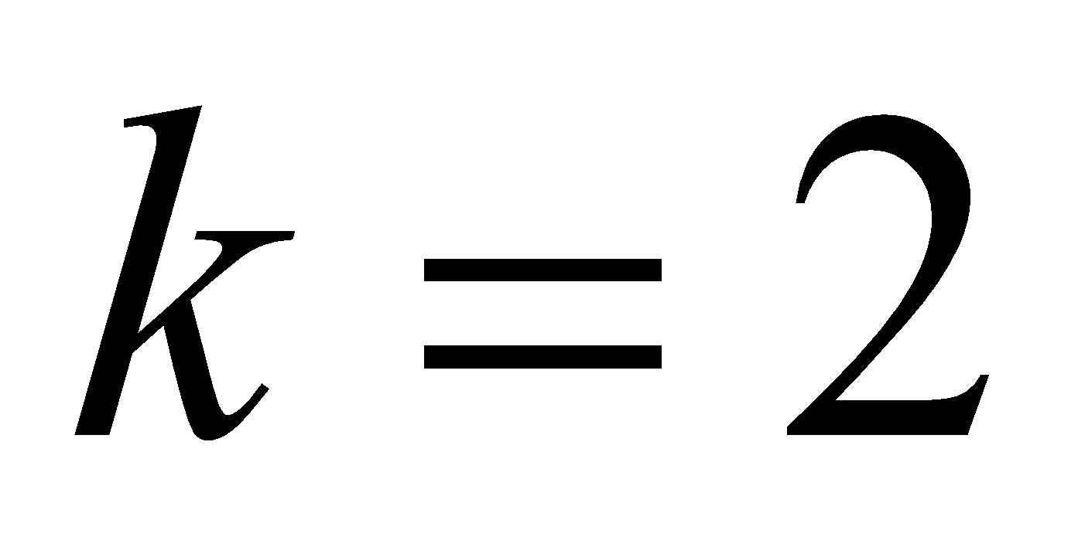
Probability estimates for calculating rule accuracy
115
Relative frequency :
  problems with small samples
Laplace estimate :
  assumes uniform prior distribution of k classes
[6+,1-] (7) = 6/7
[2+,0-] (2) = 2/2 = 1
[6+,1-] (7) = (6+1) / (7+2) = 7/9
[2+,0-] (2) = (2+1) / (2+2) = 3/4

Slide 116
Learn-one-rule:
Beam search in CN2 (Clark and Niblett 1989)
116
Beam search in CN2 learn-one-rule algorithm:
  construct BeamSize of best rule bodies (conjunctive conditions) that are statistically significant
  BestBody - min. entropy of examples covered by Body
  construct best rule R := Head ← BestBody by adding majority class of examples covered by BestBody in rule Head
A variant of CN-2 is implemented in Orange toolbox
Best performing rule learning algorithm is Ripper - JRip implementation of Ripper is implemented in WEKA toolbox

Slide 117
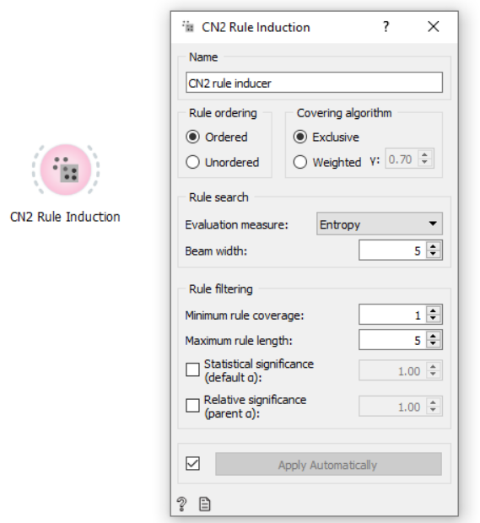
CN2 rule learner in Orange
117

Slide 118
Lesson 3:
Rule Learning
118
Transforming decision trees to rules
Classification rule learning algorithm
  Covering algorithm
  Learning individual rules
Association rule learning
Notes:
118

Slide 119
Association Rule Learning
Rules: A → B, if A then B
A and B are itemsets (records, conjunction of items), where items/features are binary-valued attributes)
Given: Transactions i1 i2 ………………… i50
itemsets (records) t1 1 1 0
t2 0 1 0
… … ………………... …
Find: A set of association rules in the form A → B
Example: Market basket analysis
  beer & coke => peanuts & chips (0.05, 0.65)
  Support: Sup(A,B) = #AB/#D = p(AB)
  Confidence: Conf(A,B) = #AB/#A = Sup(A,B)/Sup(A) = = p(AB)/p(A) = p(B|A)

Slide 120
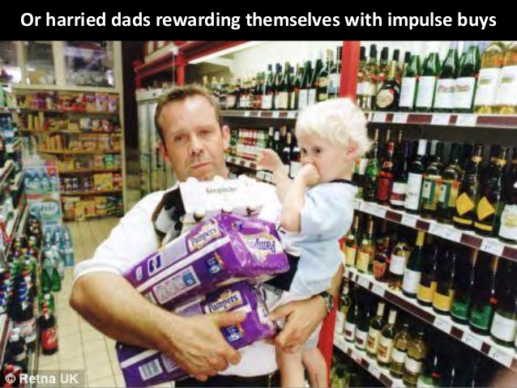
Association Rule Learning: Motivation
What people buy in a given shopping experience.
25 Osco Drug stores
1.2 million market baskets
(A market basket is the stuff you put in
the physical cart and check out at the register.)
An unexpected pattern
Between 5p.m. and 7p.m. diapers → beer
http://www.dssresources.com/newsletters/66.php

Slide 121
Association Rule Learning: Motivation
Determine associations between groups of items bought by customers.
No predefined target variable(s).
Find interesting, useful patterns and relationships.
Data mining, business intelligence.
* Terminology from market basket analysis (transactions, items, itemsets, …)

Slide 122



Support and Confidence
The dataset consists of n transactions
We have an association rule A→ B
The support of an itemset A is defined as the fraction of the transactions in the database T = {T1 . . . Tn} that contain A as a subset.
The confidence of the rule A→ B is the conditional probability of A and B occurring in a transaction, given that the transaction contains A.

Slide 123
Association Rule Learning: Examples
Market basket analysis
  beer & coke ⇒ peanuts & chips (5%, 65%)
  (IF beer AND coke THEN peanuts AND chips)
  Support 5%: 5% of all customers buy all four items
  Confidence 65%: 65% of customers that buy beer and coke also buy peanuts and chips
Insurance
  mortgage & loans & savings ⇒ insurance (2%, 62%)
  Support 2%: 2% of all customers have all four
  Confidence 62%: 62% of all customers that have mortgage, loan and savings also have insurance

Slide 124
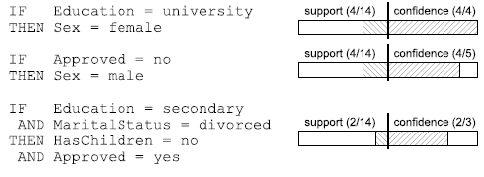
Survey data association rule learning

Slide 125
Association Rule Learning
Given: a set of transactions D
Find: all association rules that hold on the set of transactions that have
  user defined minimum support, i.e., support > MinSup, and
  user defined minimum confidence, i.e., confidence > MinConf
It is a form of exploratory data analysis, rather than hypothesis verification

Slide 126
Searching for associations
Find all large itemsets
Use the large itemsets to generate association rules
If XY is a large itemset, compute
r =support(XY) / support(X)
If r > MinConf, then X ⇒ Y holds
(support > MinSup, as XY is large)

Slide 127
Large itemsets
Large itemsets are itemsets that appear in at least MinSup transaction
All subsets of a large itemset are large itemsets (e.g., if A,B appears in at least MinSup transactions, so do A and B)
This observation is the basis for very efficient algorithms for association rules discovery (linear in the number of transactions)

Slide 128


Apriori algorithm
Frequent itemsets
Generate rules
For all frequent itemsets, find rules which satisfy the minConfidence constraint
Find all itemsets within the minSupport constraint
Association rules
*Frequent itemsets = large itemsets, sometimes also frequent patterns

Slide 129
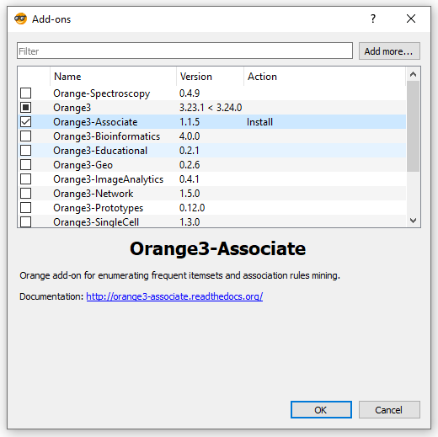

Association rules:
Orange workflow
* Start with a small minSupport and we increase it gradually (to avoid running out of memory)

Slide 130
Association vs. Classification rules rules
Exploration of dependencies
Different combinations of dependent and independent attributes
Complete search (all rules found)
Focused prediction
Predict one attribute (class) from the others
Heuristic search (subset of rules found)

Slide 131
Lesson 3
Summary and Take away messages
131
Classification rule learning addresses classification problems
Algorithms use search heuristics to search the space of possible rules in a general-to-specific manner
Training data may be noisy - rule truncation help dealing with noisy data to improve predictive accuracy on new, unlabeled data
Association rule learning is an example of descriptive induction algorithms, aimed at finding interesting patterns in data

Slide 132

Lesson 1 - 3
Summary and Take away messages
132

