Slide 1

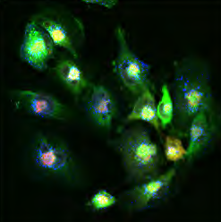
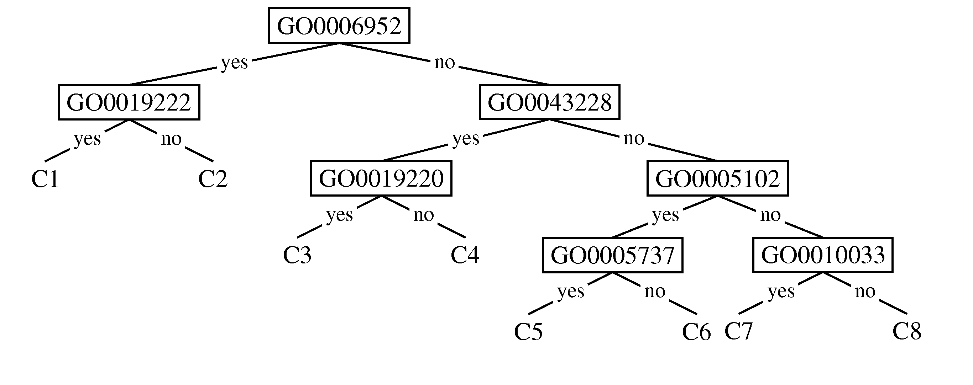
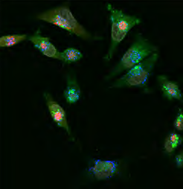
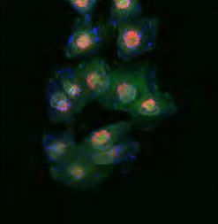
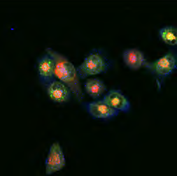
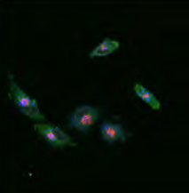
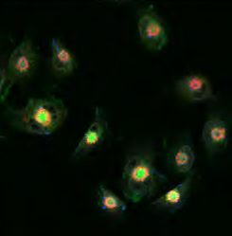
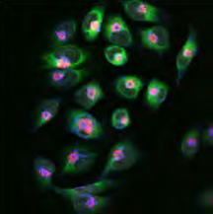
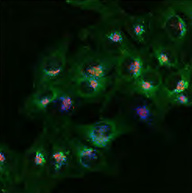
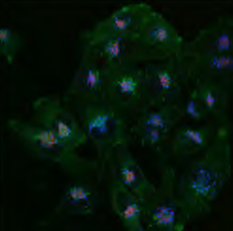
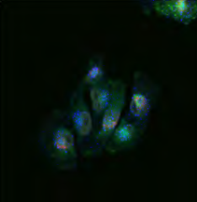
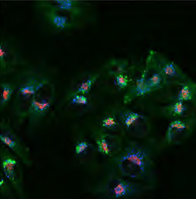
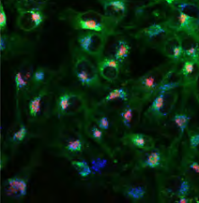
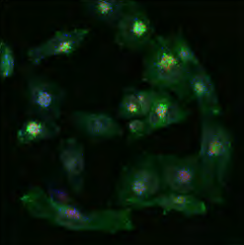
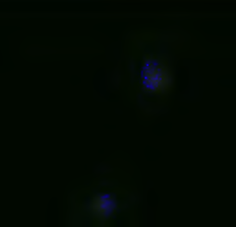
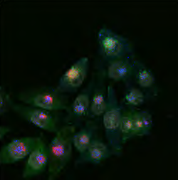
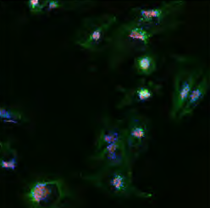
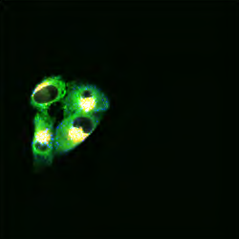
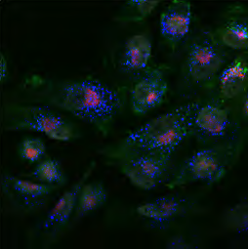
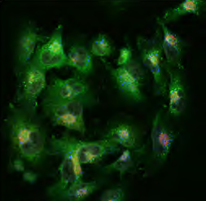
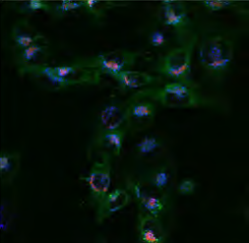
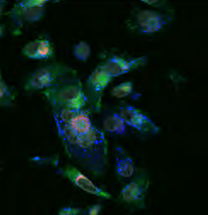
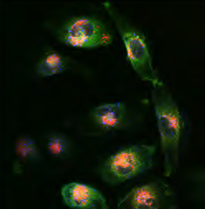
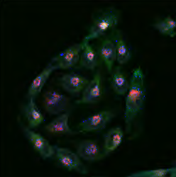
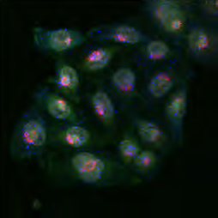
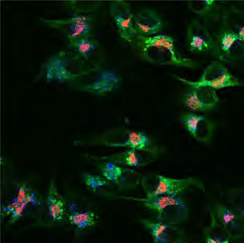
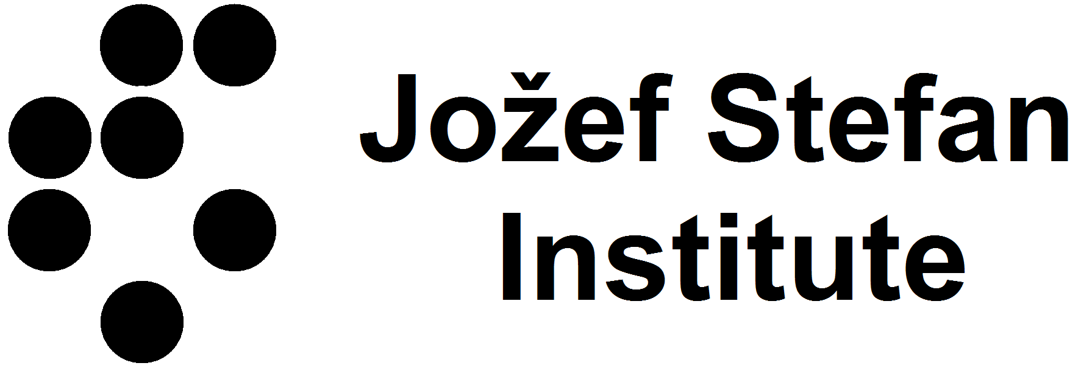
Predictive clustering relates gene annotations to
phenotype properties extracted from images
Dragi Kocev, Bernard Ženko, Petra Paul, Coenraad Kuijl, Jacques Neefjes, and Sašo Džeroski
Jožef Stefan Institute, Dept. of Knowledge Technologies, Ljubljana, Slovenia {dragi.kocev, bernard.zenko, saso.dzeroski}@ijs.si
Division of Cell Biology and Centre for Biomedical Genetics, NKI, Netherlands {p.paul, c.kuijl, j.neefjes}@nki.nl
Introduction
Data description
Grouping genes with similar phenotypes upon siRNA mediated downregulation
Phenotypes are described by features extracted from images using some free general-purpose or custom-made software (e.g., CellProfiler)
siRNA screen designed to study MHC Class II antigen presentation
  A major regulatory process in the immune system
  Controls most aspects of the adaptive immune response
  Strongly linked to almost all autoimmune diseases
siRNA screen performed on 269 genes, from which 20 were hypothetical
Each gene is described by:
  its annotation with terms from the Gene Ontology
  resulting phenotypes (images from confocal microscopy)
Only the GO terms that are used to annotate at least 1 gene from the ones analysed (in total - 334)
CellProfiler for extracting features from the images: in total 700 features, from which 13 most relevant to the study are used
Gene id | GO0000166 | GO0000267 | ... | GO0001883 |  |  |  | Feature_1 | Feature_2 | ... | Feature_t
9625 | 1 | 0 |  | 1 |  |  |  | 2.991 | -2.296 |  | 0.68
21 | 1 | 1 |  | 1 |  |  |  | -0.013 | -1.048 |  | 0.767
84519 | 0 | 0 |  | 0 |  |  |  | -0.843 | 0.155 |  | 1.396
... |  |  |  |  |  | ...
23621 | 0 | 1 | ... | 0 |  |  |  | -0.531 | 0.843 | ... | 2.304
Results
Methodology
Predictive clustering trees
Genes involved in the defense response (GO0006952) and regulation of metabolic processes (GO0019222)
Genes involved in receptor binding (GO0005102) and are present in the cytoplasm (GO0005737)
Induced by standard TDIDT algorithm
Able to make a prediction for given structured output
Heuristic score: minimization of intra-cluster variance
Definition of a distance and prototype function for a given output
Medoid is taken as a prototype in each leaf
Cosine similarity as distance measure
 | C1 | C2 | C3 | C4 | C5 | C6 | C7 | C8
Mean Cells Intensity StdIntensity GFP | -1.66 | 1.03 | -0.77 | -0.93 | -1.31 | -1.66 | 0.48 | -1.6
Mean Cells Texture AngularSecondMoment GFP 50 | -1.41 | -1.48 | 0.54 | 0.22 | 0.88 | 0.48 | -0.75 | -0.45
Mean Cytoplasm Intensity IntegratedIntensityE GFP | -1.24 | 0.25 | -0.23 | 0.54 | -1 | 0.2 | 0.07 | 2.34
Mean Cytoplasm Texture InfoMeas1 GFP 50 | 1.29 | 1.86 | 1.05 | -0.41 | 1.47 | 1.66 | 0.46 | 0.44
Mean Means ClassII per Cells AreaShape Eccentricity | 1.73 | 0.24 | -3.26 | 0.22 | -3.04 | 0.25 | 2.07 | 0.76
Mean Means ClassII per Cells Texture Entropy GFP 3 | -5.48 | 3.84 | -1.93 | -3.06 | 0.85 | -5.11 | -0.89 | -7.8
Mean Cells Children EE Count | -1.47 | 0.08 | -1.38 | 1.9 | 2.63 | 7.77 | -1.7 | 3.47
Mean Means EE per Cells AreaShape Perimeter | 2.26 | -2.24 | -2.48 | -1.96 | -1.32 | 0.28 | 0.17 | -3.37
Mean Nuclei AreaShape Solidity | 1.03 | -0.69 | -1.63 | 1.14 | 0.21 | -1.18 | -0.66 | -0.67
Mean Means Golgi per Cells Intensity IntegratedIntensity RFP | -0.5 | 0.65 | -1.69 | -0.93 | -1.55 | -1.2 | -0.42 | -0.34
Mean Means Golgi per Cells Intensity IntegratedIntensityE RFP | -1.02 | 1.49 | -1.61 | -0.6 | -1.43 | -0.8 | -0.48 | 0.79
Mean Means Golgi per Cells RadialIntensityDist FracAtD RFP 2 | 0.87 | -0.9 | -2.09 | -0.34 | -2.95 | -3.82 | 0.83 | -1.26
Mean Means Golgi per Cells RadialIntensityDist FracAtD RFP 4 | -0.98 | 1.67 | -0.17 | 0.49 | 1.12 | 1.76 | -0.92 | 2.08
Size of Cluster | 3 | 8 | 3 | 33 | 5 | 4 | 7 | 186
Ensembles of PCTs and Rule ensembles
(Randomized)
Decision tree
algorithm
Convert tree
to rules
1
(Randomized)
Decision tree
algorithm
Convert tree
to rules
2
Optimization and regularization
3
(Randomized)
Decision tree
algorithm
Convert tree
to rules
Set of
rules
IF GO0006139 = 1 AND
GO0065007 = 1 THEN
Training set
n
…
…
(Randomized)
Decision tree
algorithm
Convert tree
to rules
Genes involved in regulation (GO0065007) and in particular cellular nucleobase, nucleoside, nucleotide and nucleic acid metabolic processes (GO0006139)
n bootstrap replicates
n classifiers
Vote
Ensemble
prediction
Ensembles are able to lift the predictive performance of a single predictive clustering tree
Random forests are efficient to learn
Ensembles are not interpretable
  conversion to fitted rule ensembles
Each tree from the ensembles is converted to a set of rules
Using some optimization techniques, select the rule set with best performance
Easy to interpret by domain experts
Conclusions
Application of the predictive clustering paradigm for analysis of phenotype images from siRNA screen for MHC Class II antigen presentation
The clusters and their descriptions are obtained in a single step
Identified and described groups of genes which yield similar phenotypes upon siRNA mediated downregulation

