Slide 1
Hierarchical Classification of
Diatom Images using
Predictive Clustering Trees
Ivica Dimitrovski¹, Dragi Kocev²,
Suzana Loskovska¹, Sašo Džeroski²
¹ Faculty of Electrical Engineering and Information Technologies, Department of Computer Science, Skopje, Macedonia
² Jožef Stefan Institute, Department of Knowledge Technologies, Ljubljana, Slovenia

Slide 2
Outline
Hierarchical multi-label classification system for diatom image classification
Contour and feature extraction from images
Predictive Clustering Trees
Ensembles: Bagging and random forests
Experimental Design
Results and Discussion

Slide 3
Diatom image classification (1)
Diatoms: large and ecologically important group of unicellular or colonial organisms (algae)
Variety of uses: water quality monitoring, paleoecology and forensics

Slide 4
Diatom image classification (2)
200000 different diatom species, half of them still undiscovered
Automatic diatom classification
  image processing (feature extraction from images)
  image classification (labels and groups the images)
Labels can be organized in a hierarchy and an image can be labeled with more than one label
Predict all different levels in the hierarchy of taxonomic ranks: genus, species, variety, and form
Goal of the complete system: assist a taxonomist in identifying a wide range of different diatoms

Slide 5
Diatom image classification (3)
Set of images with their visual descriptors and annotations
Taxonomic rank with hierarchical structure

Slide 6
Contour extraction from images
Pre-segmentation of an image
  separate the diatom objects from dark or light debris
  identify the regions with structured objects
  merge nested regions
Edge-based thresholding for contour extraction
  locate the boundary between the objects and the background
  produce a binary (black and white) image with the diatom contours
Contour following
  trace the region borders in the binary image

Slide 7
Feature extraction from images
Simple geometric properties
  length, width, size and the length-width ratio
Simple shape descriptors
  rectangularity, triangularity, compactness, ellipticity, and circularity
Fourier descriptors
  30 coefficients
SIFT histograms
  Invariant to changes in illumination, image noise, rotation, scaling, and small changes in viewpoint

Slide 8
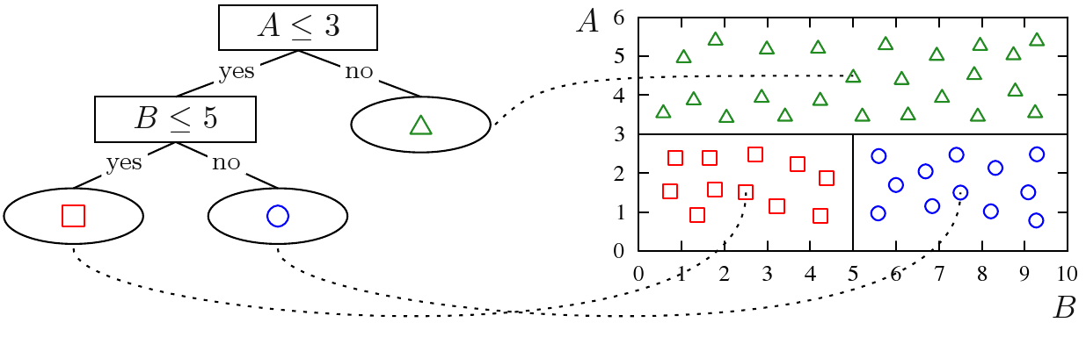
Predictive Clustering Trees (PCTs)
Standard Top-Down Induction of DTs
Hierarchy of clusters
Distance measure: minimization of intra-cluster variance
Instantiation of the variance for different tasks
  Multiple targets, sequences, hierarchies

Slide 9
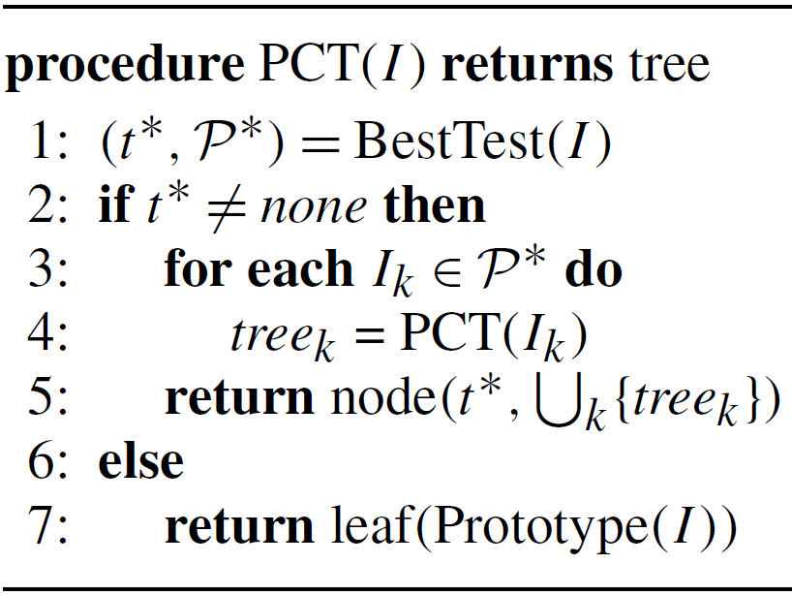
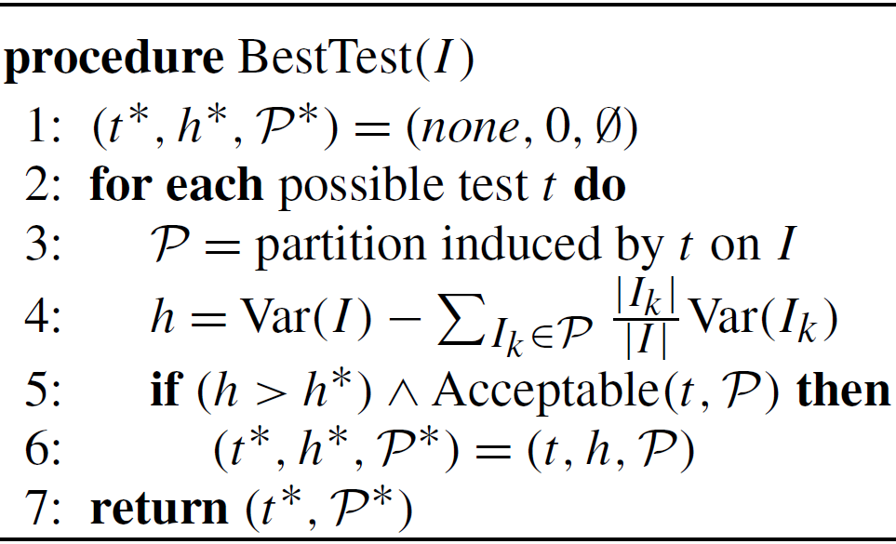
CLUS
System where the PCTs framework is implemented (KULeuven & JSI)
Available for download at http://www.cs.kuleuven.be/~dtai/clus
The top-down induction algorithm for PCTs:
Selecting the tests: reduction in variance caused by partitioning the instances
Notes:
9

Slide 10
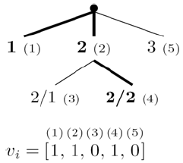
PCTs for Hierarchical Multi-Label Classification
HMLC: an example can be labeled with multiple labels that are organized in a hierarchy
{ 1, 2, 2.2 }
Notes:
In the HMC context, it makes sense to consider similarity on higher levels of the
hierarchy more important than similarity on lower levels. To that aim, we use a weighted Euclidean distance

Slide 11
PCTs for Hierarchical Multi-Label Classification
Variance: average squared distance between each example’s label and the set’s mean label
Weighted Euclidean distance: an error at the upper levels costs more than an error at the lower levels

Slide 12
Ensemble methods
Ensembles are a set of predictive models
  Unstable base classifiers
Voting schemes to combine the predictions into a single prediction
Ensemble learning approaches
  Modification of the data
  Modification of the algorithm
Random
Forest
Bagging

Slide 13

Ensemble methods
Test set
Test set
Test set
Test set
(Randomized)
(Randomized)
(Randomized)
(Randomized)
Decision tree
Decision tree
Decision tree
Decision tree
L
L
L
L
1
1
1
algorithm
1
algorithm
algorithm
algorithm
1
1
1
1
(Randomized)
(Randomized)
(Randomized)
(Randomized)
Decision tree
Decision tree
Decision tree
Decision tree
L
L
L
L
2
2
2
2
2
2
2
2
algorithm
algorithm
algorithm
algorithm
3
3
3
3
L
L
L
L
(Randomized)
(Randomized)
(Randomized)
(Randomized)
vote
vote
vote
Decision tree
vote
Decision tree
Decision tree
Decision tree
L
L
L
L
3
3
3
Training set
3
Training set
Training set
Training set
algorithm
algorithm
algorithm
algorithm
n
n
n
n
…
…
…
…
…
…
…
…
(Randomized)
(Randomized)
(Randomized)
(Randomized)
L
L
L
Decision tree
L
Decision tree
Decision tree
Decision tree
n
n
n
n
algorithm
algorithm
algorithm
algorithm
n classifiers
n classifiers
n classifiers
n classifiers
n predictions
n predictions
n predictions
n bootstrap
n predictions
n bootstrap
n bootstrap
n bootstrap
replicates
replicates
replicates
replicates
Image from van Assche, PhD Thesis, 2008

Slide 14
Ensemble methods
Test set
Test set
Test set
Test set
(Randomized)
(Randomized)
(Randomized)
CLUS
Decision tree
Decision tree
Decision tree
L
L
L
L
1
1
1
algorithm
1
algorithm
algorithm
1
1
1
1
(Randomized)
(Randomized)
(Randomized)
CLUS
Decision tree
Decision tree
Decision tree
L
L
L
L
2
2
2
2
2
2
2
2
algorithm
algorithm
algorithm
3
3
3
3
L
L
L
L
(Randomized)
(Randomized)
(Randomized)
CLUS
vote
vote
vote
Decision tree
vote
Decision tree
Decision tree
L
L
L
L
3
3
3
Training set
3
Training set
Training set
Training set
algorithm
algorithm
algorithm
n
n
n
n
…
…
…
…
…
…
…
…
(Randomized)
(Randomized)
(Randomized)
CLUS
L
L
L
Decision tree
L
Decision tree
Decision tree
n
n
n
n
algorithm
algorithm
algorithm
n classifiers
n classifiers
n classifiers
n classifiers
n predictions
n predictions
n predictions
n bootstrap
n predictions
n bootstrap
n bootstrap
n bootstrap
replicates
replicates
replicates
replicates
Image from van Assche, PhD Thesis, 2008

Slide 15
ADIAC diatom image database
Three different subset of images:
  1099 images classified in 55 different taxa
  1020 images classified in 48 different taxa
  819 images classified in 37 different taxa
The diatoms vary in shape and ornamentation

Slide 16
Experimental design – classifier
Random Forests and Bagging of PCTs for HMLC:
  Feature Subset Size: 10% of the number of descriptive attributes
  Number of classifiers: 100 un-pruned trees
  Combine the predictions output by the base classifiers: probability distribution vote

Slide 17
Results (1)
Predictive performance of the feature extraction algorithms and their combination
Classifier | Descriptors | # features | Overall recognition rate [%]
 |  |  | 55 diatom taxa | 48 diatom taxa | 37 diatom taxa
Bagging | Geometric and shape descriptors | 9 | 76.3 | 76.7 | 77.2
 | Fourier descriptors | 30 | 86.7 | 88.1 | 88.6
 | SIFT histograms | 200 | 88.4 | 89.2 | 91.3
 | Geometric and shape desc.+Fourier desc.+SIFT hist. | 239 | 96.2 | 98.1 | 98.8
Random Forests | Geometric and shape descriptors | 9 | 76.3 | 76.7 | 77.2
 | Fourier descriptors | 30 | 86.6 | 88.1 | 88.7
 | SIFT histograms | 200 | 88.2 | 87.9 | 91.1
 | Geometric and shape desc.+Fourier desc.+SIFT hist. | 239 | 96.2 | 98.1 | 98.7

Slide 18
Results (1)
Predictive performance of the feature extraction algorithms and their combination
Classifier | Descriptors | # features | Overall recognition rate [%]
 |  |  | 55 diatom taxa | 48 diatom taxa | 37 diatom taxa
Bagging | Geometric and shape descriptors | 9 | 76.3 | 76.7 | 77.2
 | Fourier descriptors | 30 | 86.7 | 88.1 | 88.6
 | SIFT histograms | 200 | 88.4 | 89.2 | 91.3
 | Geometric and shape desc.+Fourier desc.+SIFT hist. | 239 | 96.2 | 98.1 | 98.8
Random Forests | Geometric and shape descriptors | 9 | 76.3 | 76.7 | 77.2
 | Fourier descriptors | 30 | 86.6 | 88.1 | 88.7
 | SIFT histograms | 200 | 88.2 | 87.9 | 91.1
 | Geometric and shape desc.+Fourier desc.+SIFT hist. | 239 | 96.2 | 98.1 | 98.7

Slide 19
Comparison of the performance of the ensembles of PCTs to the performance of the approaches from H. du Buf, M. M. Bayer (Eds.), Automatic diatom identification, World Scientific Publishing, 2002, pp. 245–257
Data |  | Descriptors | Classifier | Evaluation | Recognition Rate [%]
# Images | # Taxa
1099 | 55 | geometric and shape; Fourier; SIFT | Bagging of predictive clustering trees | 10-fold cross-validation | 96.2
1020 | 48 | geometric and shape; Fourier; SIFT | Bagging of predictive clustering trees | 10-fold cross-validation | 98.1
1009 | 48 | contour profiling; Legendre polynomials | Decision trees; Neural networks; syntactical classifier | Random separation (50/50) to train and test set | 82
808 | 38 | geometric; shape; Fourier; image moments; ornamentation and morphological | Bagging of Decision Trees | Leave One Out | 94.9
819 | 37 | geometric and shape; Fourier; SIFT | Bagging of predictive clustering trees | 10-fold cross-validation | 98.8
781 | 37 | contour; segment; global | nearest -mean classifier | set swaping (complex pseudo cross-validation) | 82.9
781 | 37 | Gabor; Legendre polynomials; ornamentation | Decision trees; Bayesian classifier | Random separation (50/50) to train and test set | 88
781 | 37 | contour; ornamentation | Bagging of Decision Trees | 10 times random separation (75/25) train and test | 89.6
781 | 37 | Gabor; Legendre polynomials; ornamentation; contour; global; geometric; shape; Fourier; image moments; morphological | Bagging of Decision Trees | 10 times random separation (75/25) train and test | 96.9

Slide 20
Comparison of the performance of the ensembles of PCTs to the performance of the approaches from H. du Buf, M. M. Bayer (Eds.), Automatic diatom identification, World Scientific Publishing, 2002, pp. 245–257
Data |  | Descriptors | Classifier | Evaluation | Recognition Rate [%]
# Images | # Taxa
1099 | 55 | geometric and shape; Fourier; SIFT | Bagging of predictive clustering trees | 10-fold cross-validation | 96.2
1020 | 48 | geometric and shape; Fourier; SIFT | Bagging of predictive clustering trees | 10-fold cross-validation | 98.1
1009 | 48 | contour profiling; Legendre polynomials | Decision trees; Neural networks; syntactical classifier | Random separation (50/50) to train and test set | 82
808 | 38 | geometric; shape; Fourier; image moments; ornamentation and morphological | Bagging of Decision Trees | Leave One Out | 94.9
819 | 37 | geometric and shape; Fourier; SIFT | Bagging of predictive clustering trees | 10-fold cross-validation | 98.8
781 | 37 | contour; segment; global | nearest -mean classifier | set swaping (complex pseudo cross-validation) | 82.9
781 | 37 | Gabor; Legendre polynomials; ornamentation | Decision trees; Bayesian classifier | Random separation (50/50) to train and test set | 88
781 | 37 | contour; ornamentation | Bagging of Decision Trees | 10 times random separation (75/25) train and test | 89.6
781 | 37 | Gabor; Legendre polynomials; ornamentation; contour; global; geometric; shape; Fourier; image moments; morphological | Bagging of Decision Trees | 10 times random separation (75/25) train and test | 96.9

Slide 21
Results (2)
The presented approach has very high predictive performance (ranging from 96.2% to 98.7%)
Recognition rates of 100% for the majority of taxa
Lower recognition rates are achieved for taxa that are very similar to each other and difficult to distinguish
  Eunotia diatoms (presented on image), Fallacia diatoms
Our results are better than the ones obtained from human annotators (63.3% recognition rate)

Slide 22
Conclusion
Novel approach to taxonomic identification of taxa from microscopic images
Different feature extraction approaches and hierarchical multi-label classification
Very high predictive performance - the best reported performance on this dataset

